Slide 1
United States Migration
Where people live and where they come from...

Slide 2
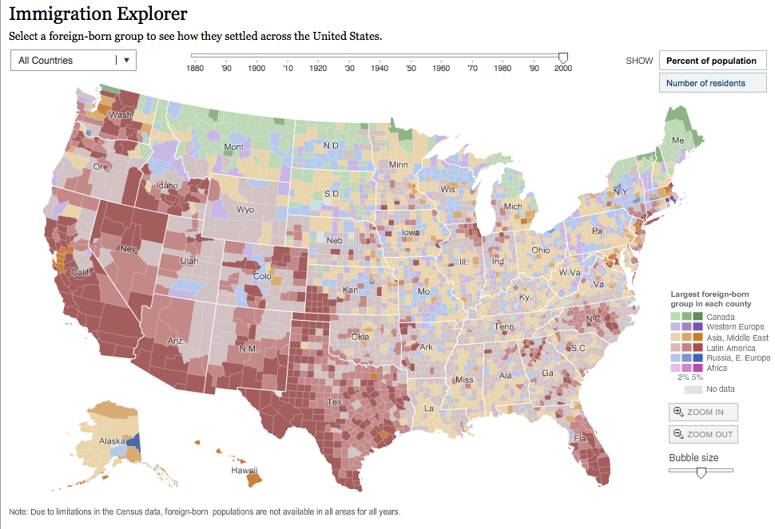
http://www.nytimes.com/interactive/2009/03/10/us/20090310-immigration-explorer.html?_r=0

Slide 3
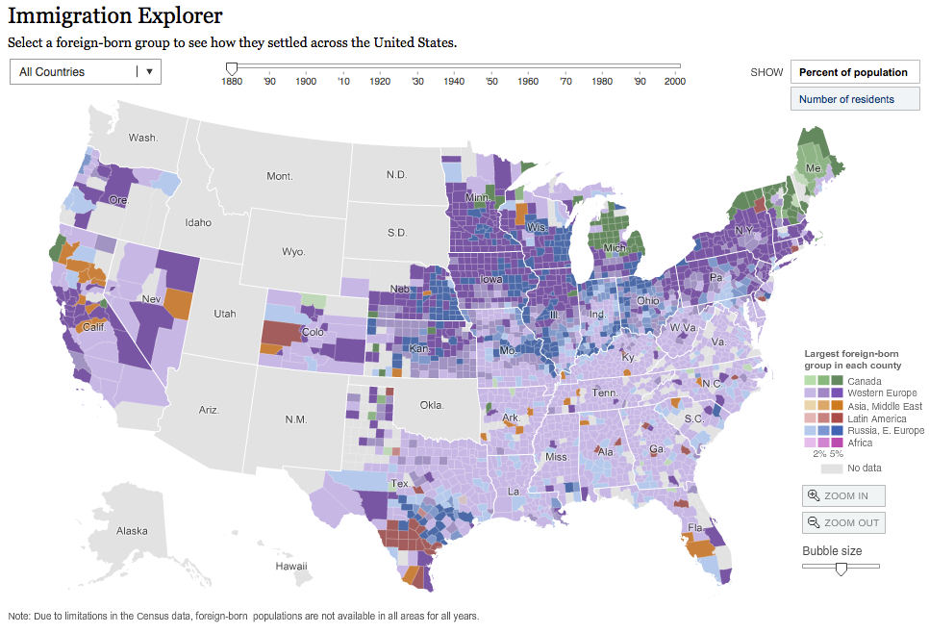

Slide 4
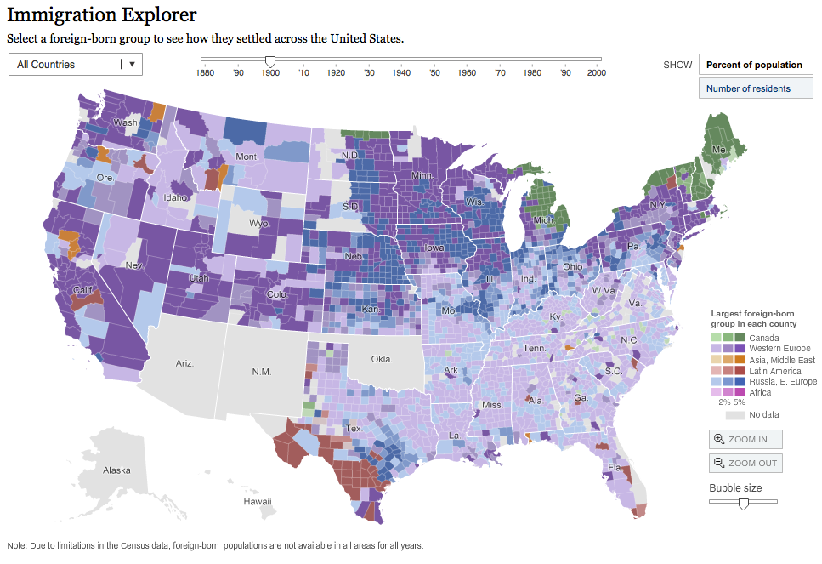

Slide 5
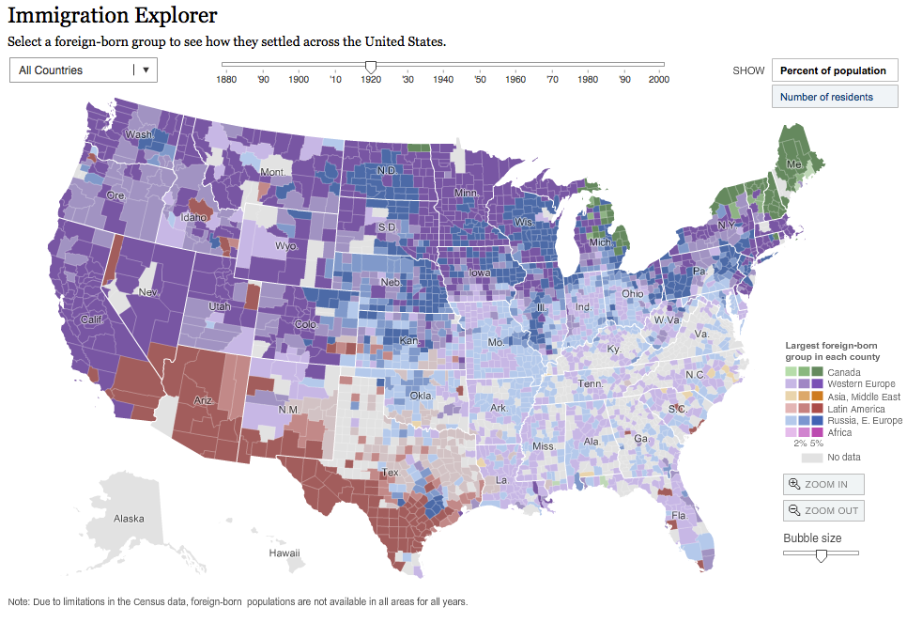

Slide 6
https://www.census.gov/population/www/cen2000/censusatlas/pdf/9_Ancestry.pdf

Slide 7
Ethnic Group | Western and Eastern Europe | Asian
Color on Map | Blue | Red

Slide 10
http://www.valpo.edu/geomet/geo/courses/geo200/usa_maps.html

Slide 11
Ethnic Group | Italian and Irish
Color on Map | Green

Slide 12
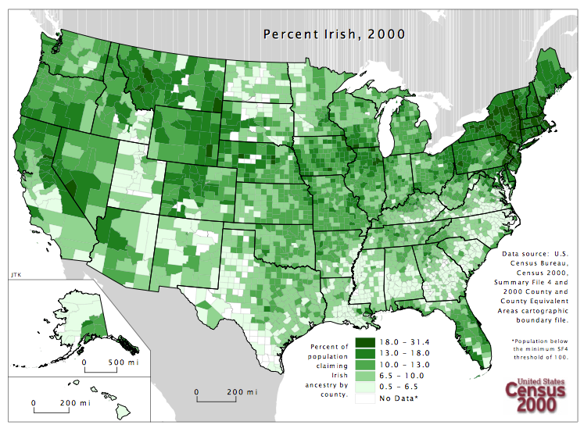

Slide 13
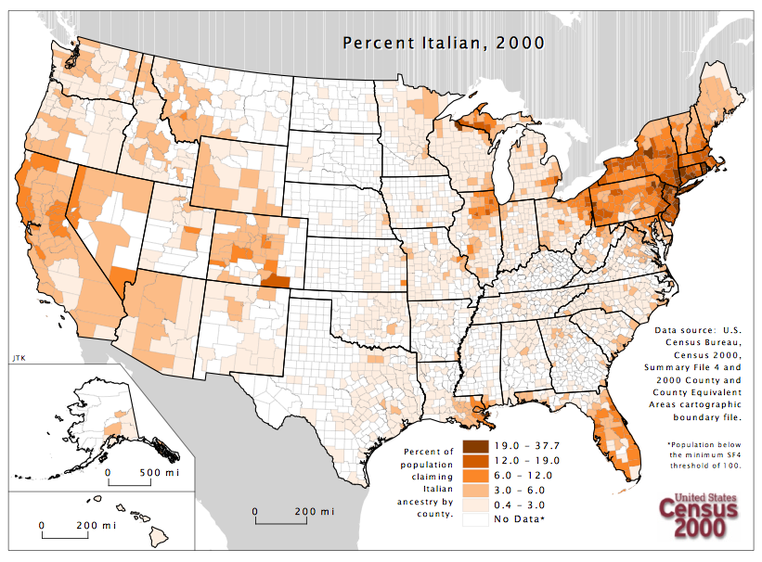

Slide 14
Ethnic Group | Chinese and Japanese
Color on Map | Brown

Slide 15
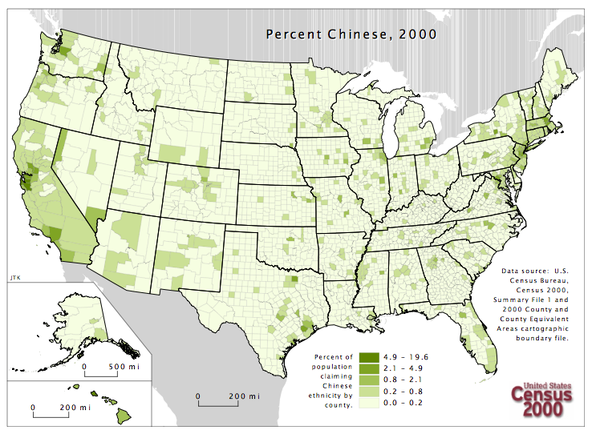

Slide 16
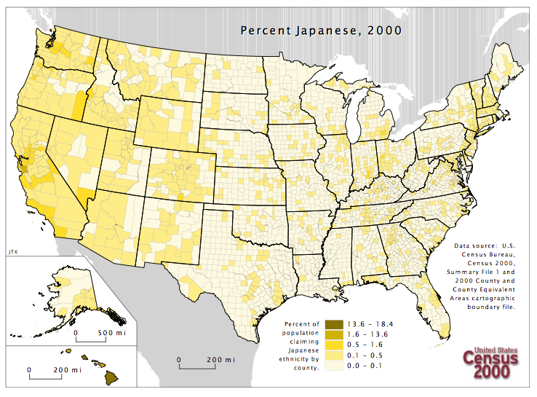

Slide 17
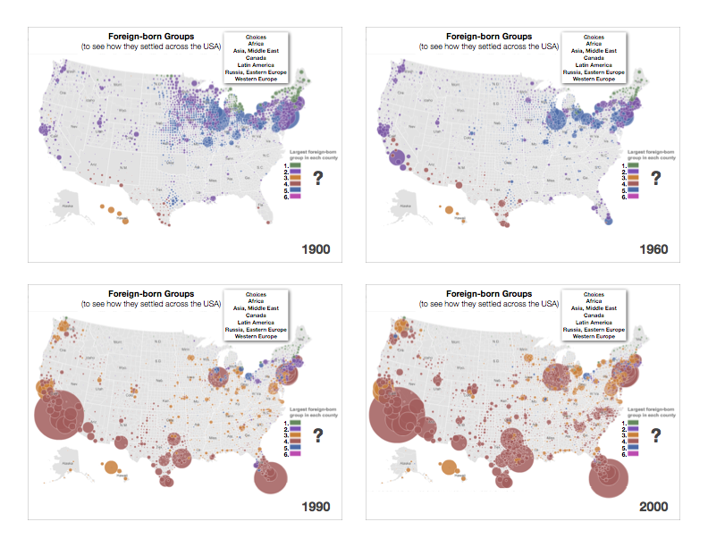
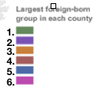

Slide 18
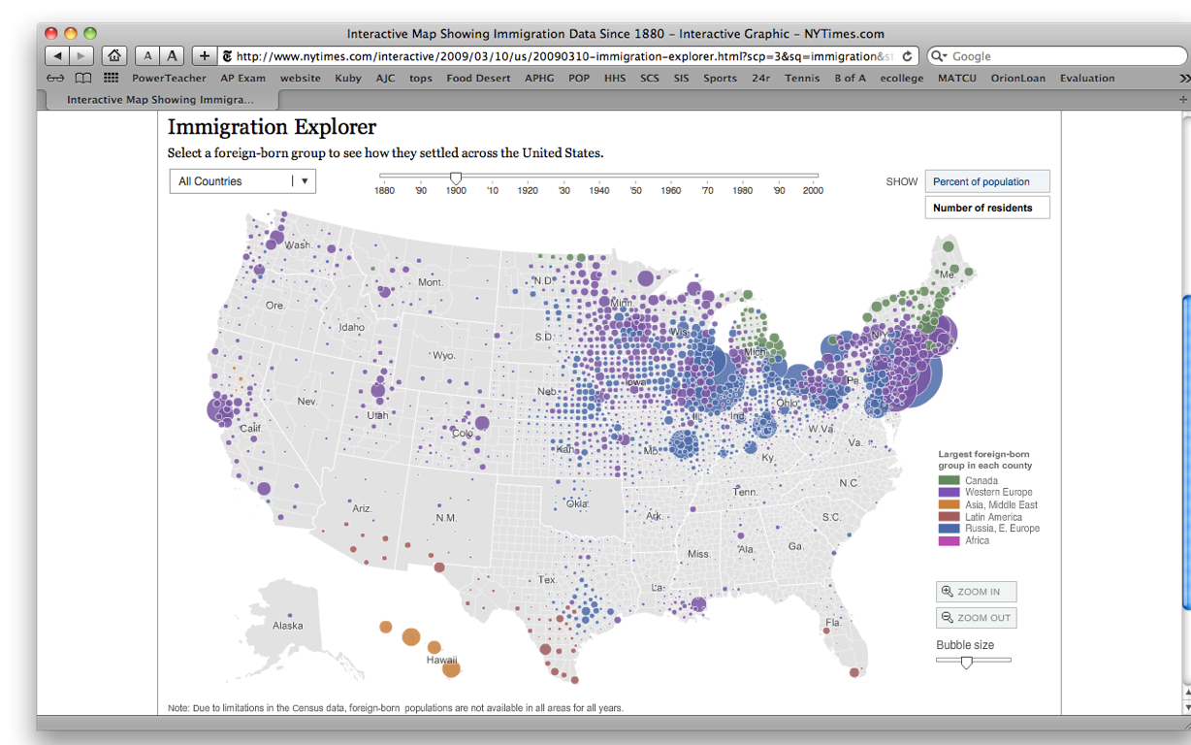
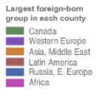
Foreign-born Groups
(to see how they settled across the USA)
Choices
Africa
Asia, Middle East
Canada
Latin America
Russia, Eastern Europe
Western Europe
1.
?
2.
3.
4.
5.
6.
1900

Slide 19
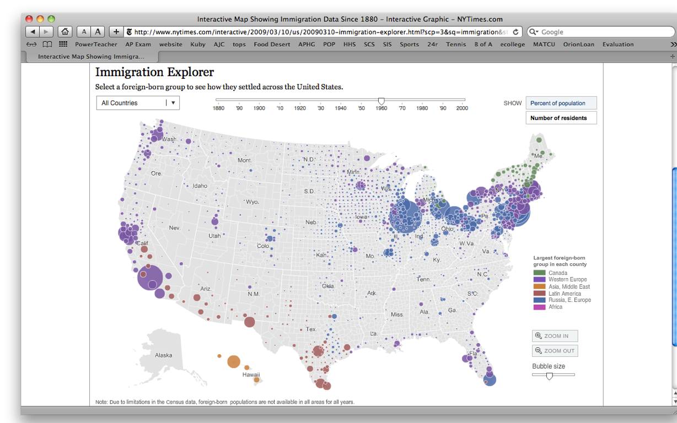
Foreign-born Groups
(to see how they settled across the USA)
Choices
Africa
Asia, Middle East
Canada
Latin America
Russia, Eastern Europe
Western Europe
1.
?
2.
3.
4.
5.
6.
1960

Slide 20
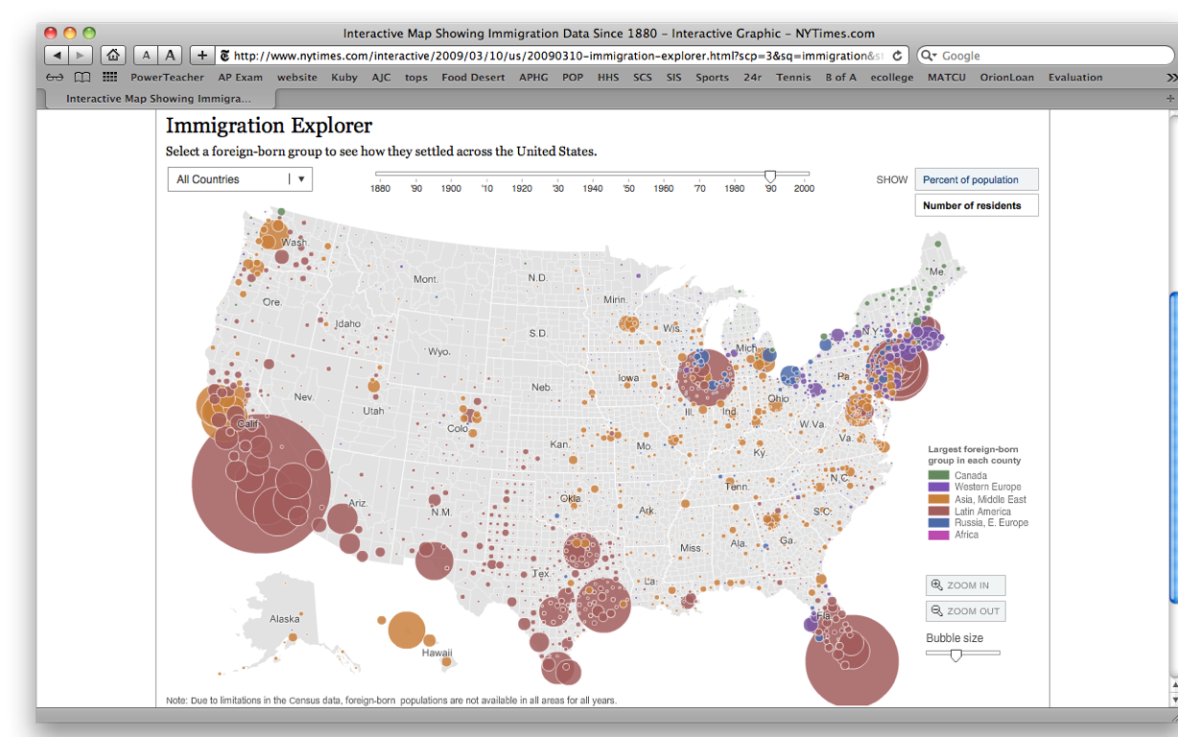
Foreign-born Groups
(to see how they settled across the USA)
Choices
Africa
Asia, Middle East
Canada
Latin America
Russia, Eastern Europe
Western Europe
1.
?
2.
3.
4.
5.
6.
1990

Slide 21
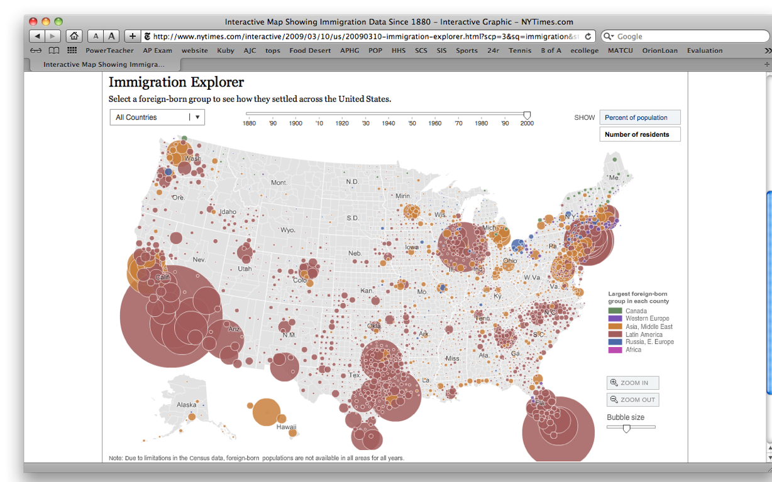
Foreign-born Groups
(to see how they settled across the USA)
Choices
Africa
Asia, Middle East
Canada
Latin America
Russia, Eastern Europe
Western Europe
1.
?
2.
3.
4.
5.
6.
2000

Slide 22
Foreign-born Groups
(to see how they settled across the USA)
Choices
Africa
Asia, Middle East
Canada
Latin America
Russia, Eastern Europe
Western Europe
1.
Canada
2.
?
Western Europe
3.
Asia, MIddle East
4.
Latin America
5.
Russia, E. Europe
6.
Africa
ANSWERS
2000

Slide 23
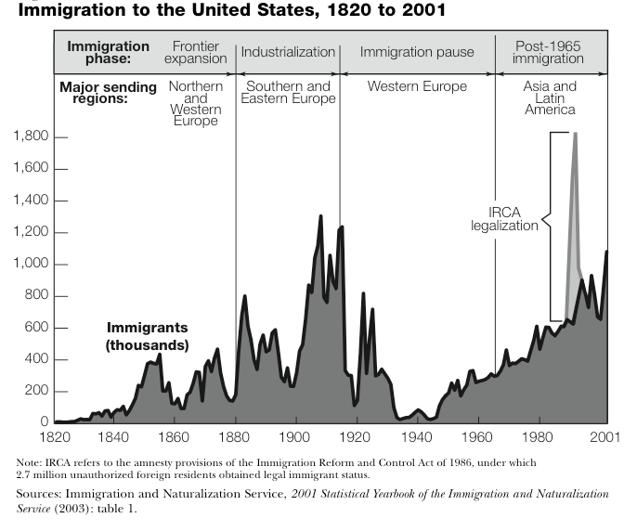
1
2
3
4
What are the “major sending regions?”

Slide 24
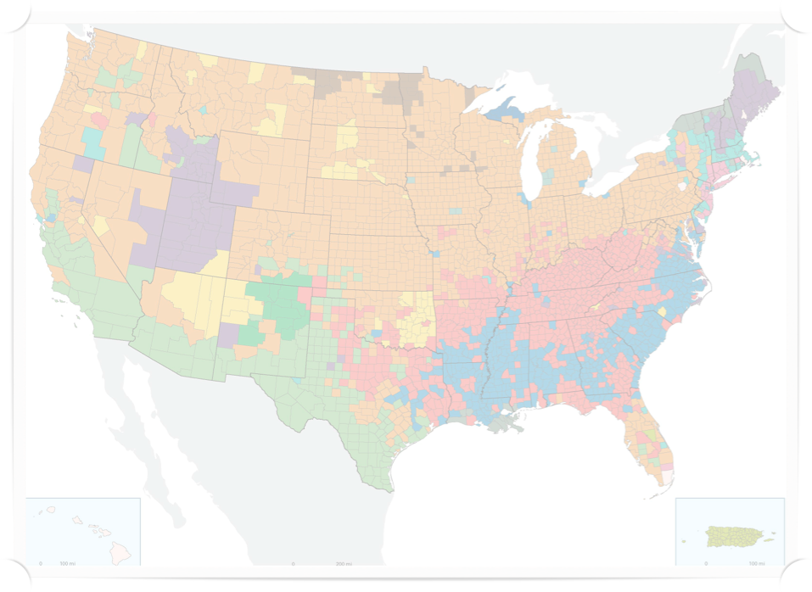
http://www.census.gov/population/www/cen2000/censusatlas/pdf/9_Ancestry.pdf

Slide 25
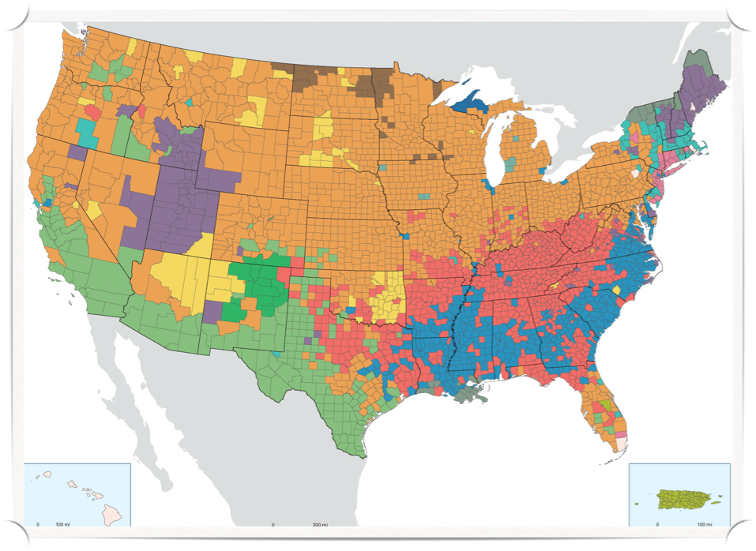
Prevalent Ancestry, 2000

Slide 26
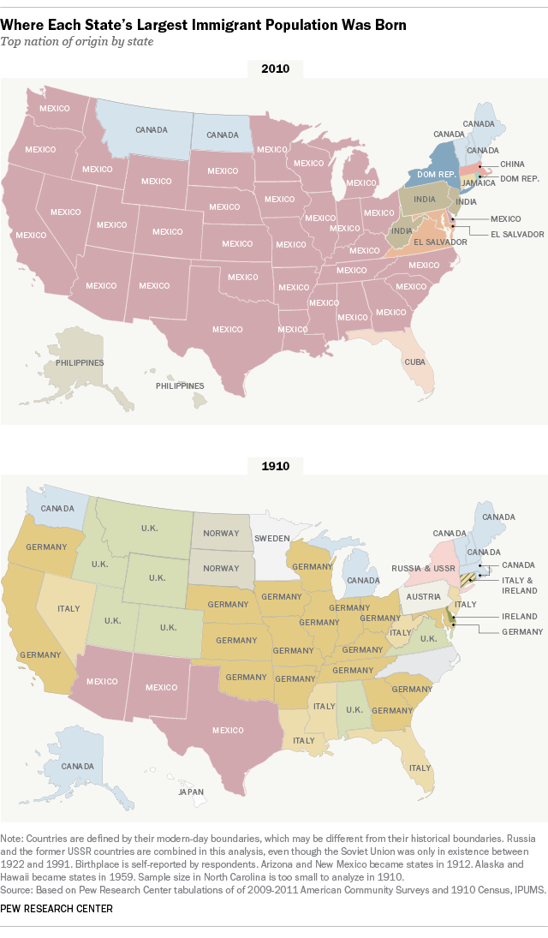

Slide 28
Which countries are not found in 2010?
Which countries are on the map in 2010 but not in 1910?
China
Cuba
Dominican Republic
El Salvador
India
Jamaica
Philippines
Austria
German
Ireland
Italy
Japan
Norway
Sweden
U.K.

