Slide 1
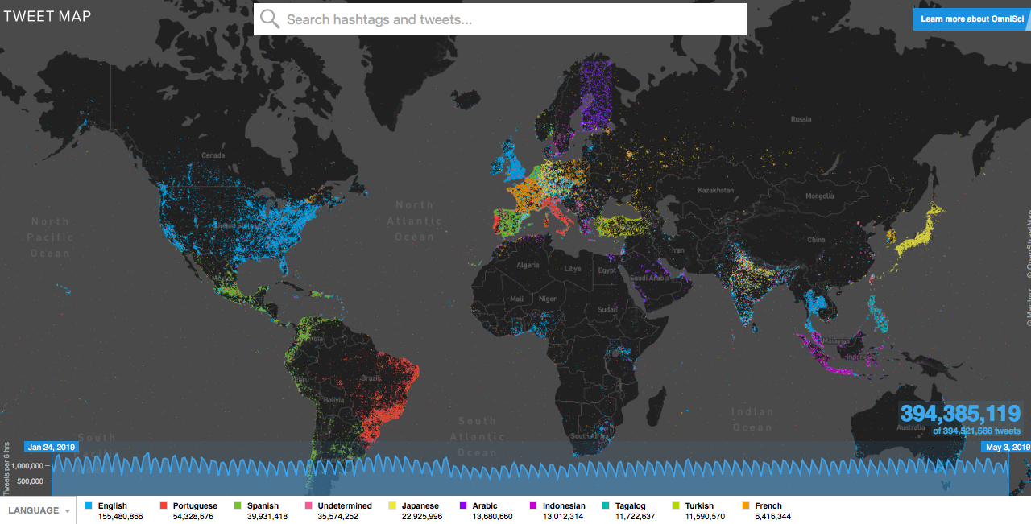
Twitter Language Map Activities

Slide 2
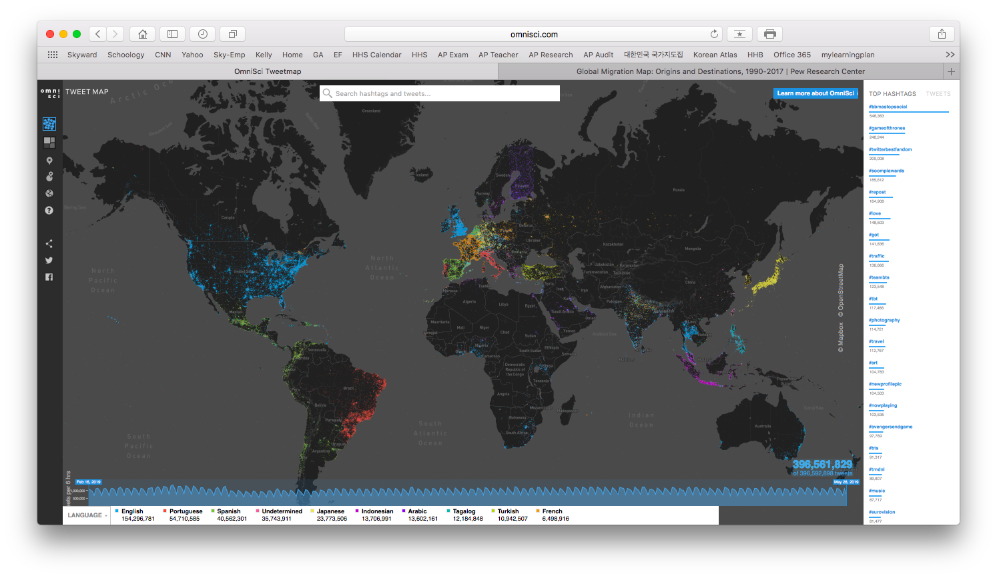
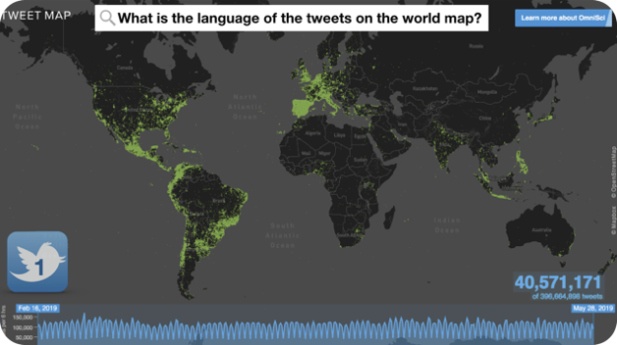
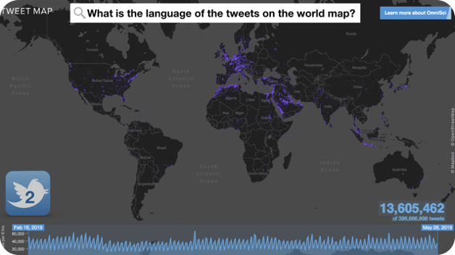
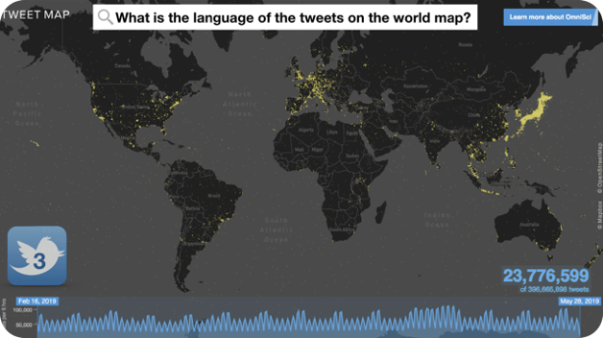
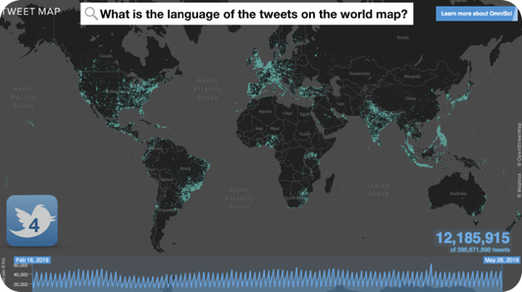
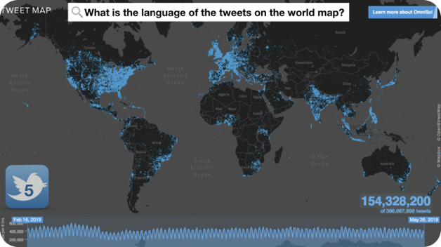
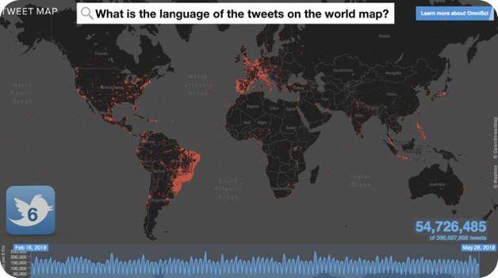
What is the language of the tweets on the world map?

Slide 3
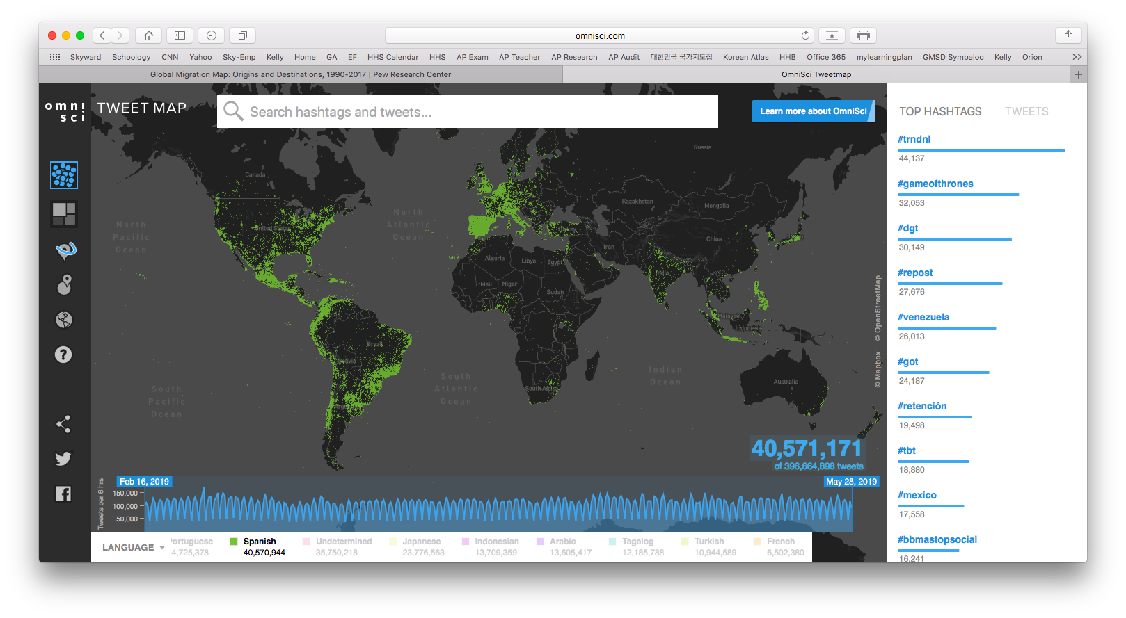
What is the language of the tweets on the world map?
Answer Choices…
Arabic
English
Japanese
Portuguese
Spanish
Tagalog
1

Slide 4
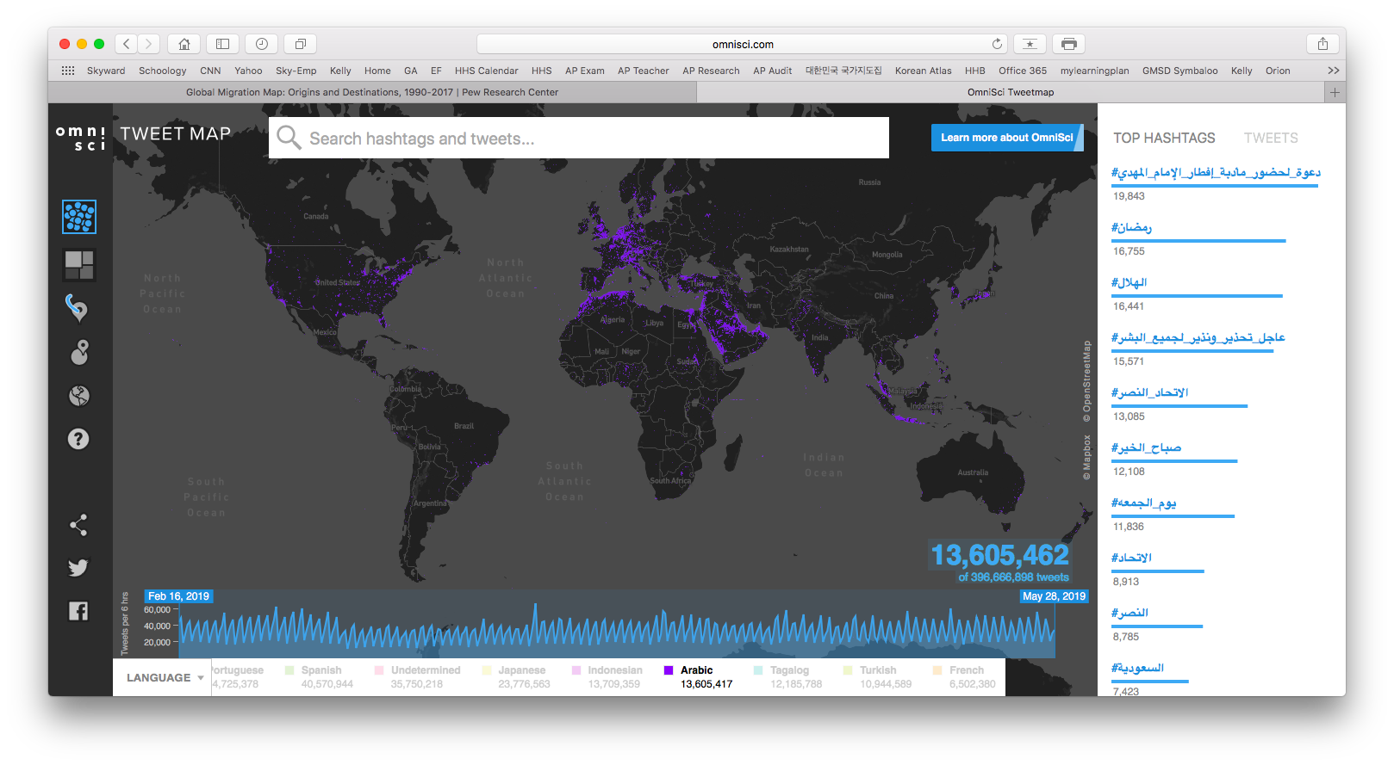
What is the language of the tweets on the world map?
Answer Choices…
Arabic
English
Japanese
Portuguese
Spanish
Tagalog
2

Slide 5
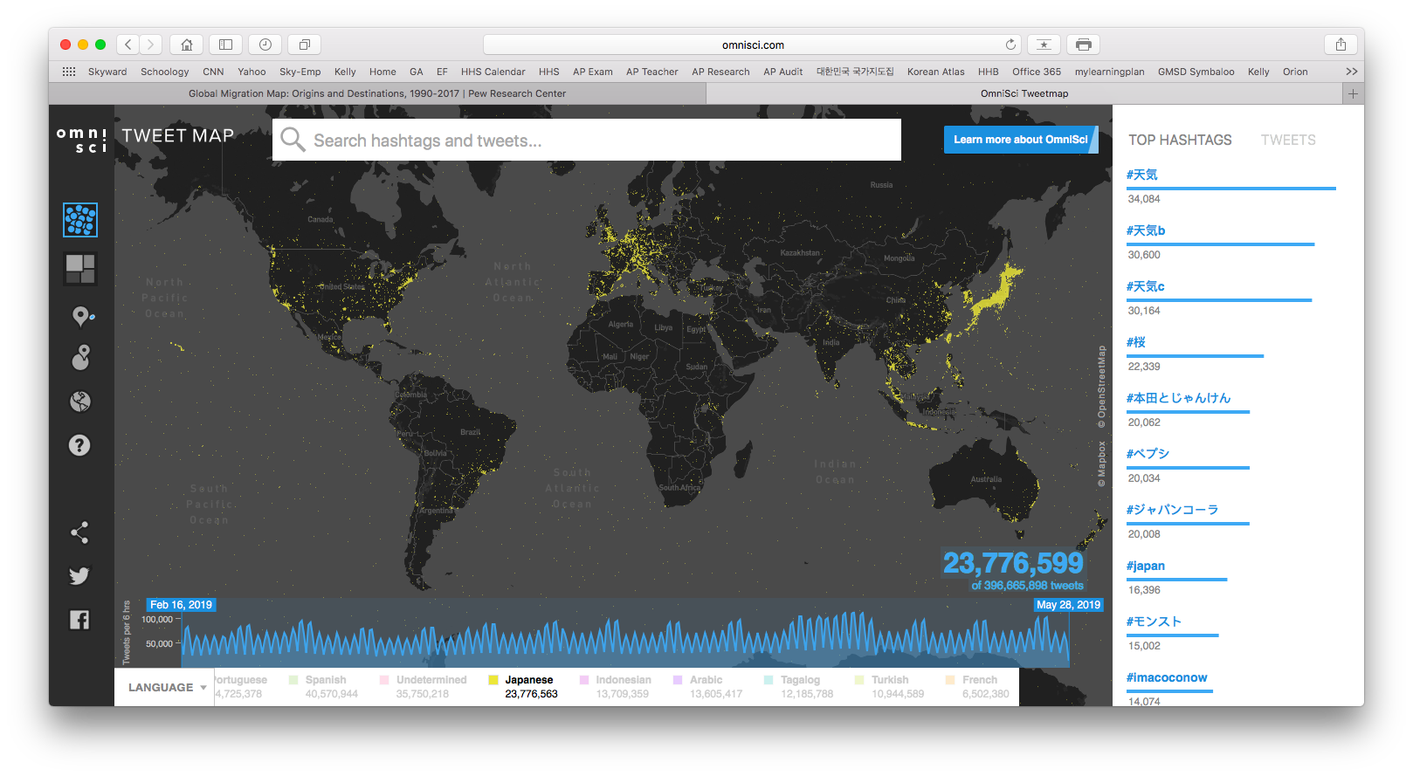
What is the language of the tweets on the world map?
Answer Choices…
Arabic
English
Japanese
Portuguese
Spanish
Tagalog
3

Slide 6
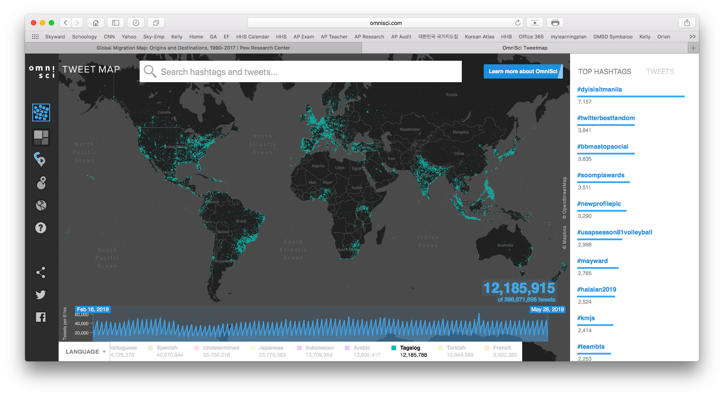
What is the language of the tweets on the world map?
Answer Choices…
Arabic
English
Japanese
Portuguese
Spanish
Tagalog
4

Slide 7
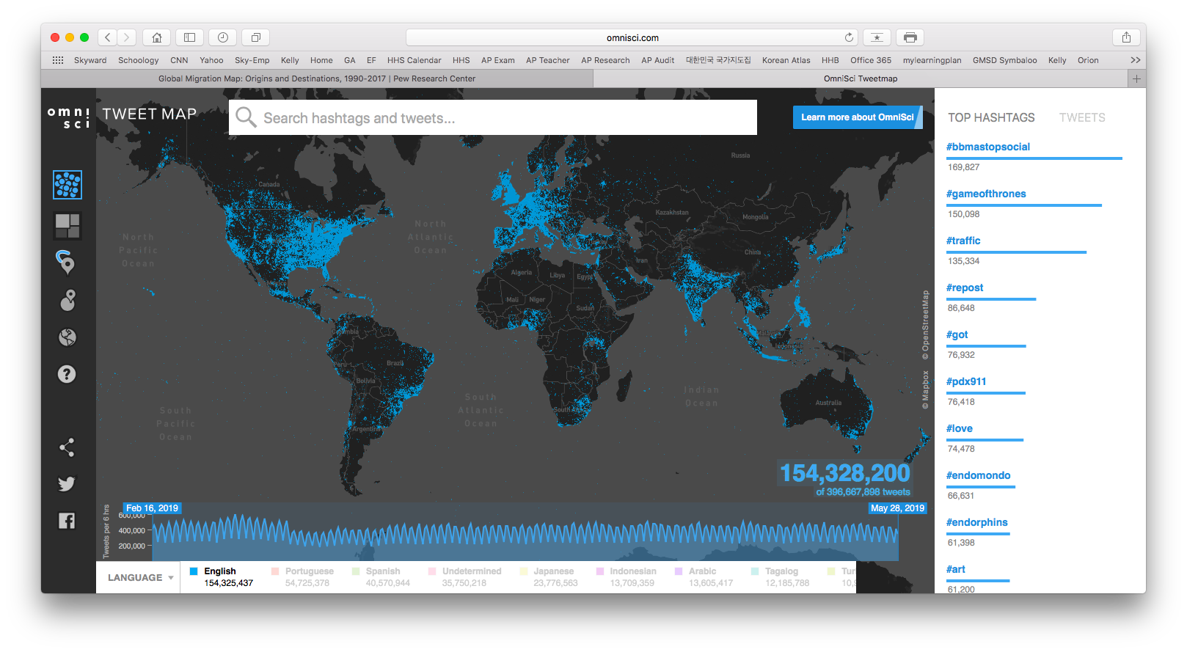
What is the language of the tweets on the world map?
Answer Choices…
Arabic
English
Japanese
Portuguese
Spanish
Tagalog
5

Slide 8
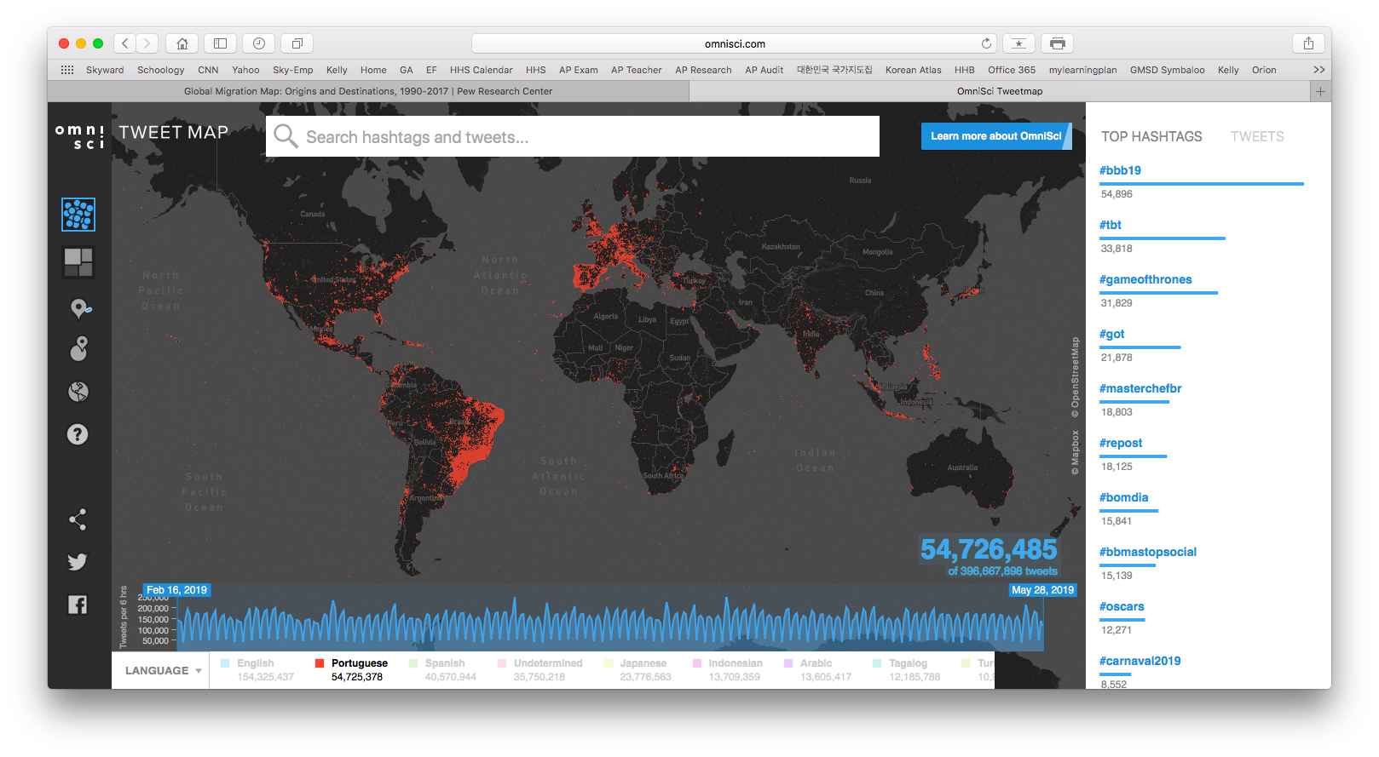
What is the language of the tweets on the world map?
Answer Choices…
Arabic
English
Japanese
Portuguese
Spanish
Tagalog
6

Slide 9
What is the language of the tweets on the world map?

Slide 10
ANSWERS

Slide 11
What is the language of the tweets on the world map?
Spanish
Answer Choices…
Arabic
English
Japanese
Portuguese
Spanish
Tagalog
1

Slide 12
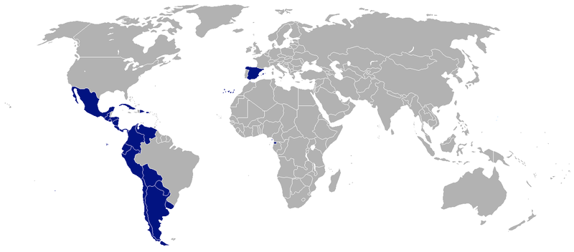
Spanish

Slide 13
What is the language of the tweets on the world map?
Arabic
Answer Choices…
Arabic
English
Japanese
Portuguese
Spanish
Tagalog
2

Slide 14
What is the language of the tweets on the world map?
Japanese
Answer Choices…
Arabic
English
Japanese
Portuguese
Spanish
Tagalog
3

Slide 15
What is the language of the tweets on the world map?
Tagalog
Answer Choices…
Arabic
English
Japanese
Portuguese
Spanish
Tagalog
4

Slide 16
What is the language of the tweets on the world map?
English
Answer Choices…
Arabic
English
Japanese
Portuguese
Spanish
Tagalog
5

Slide 17
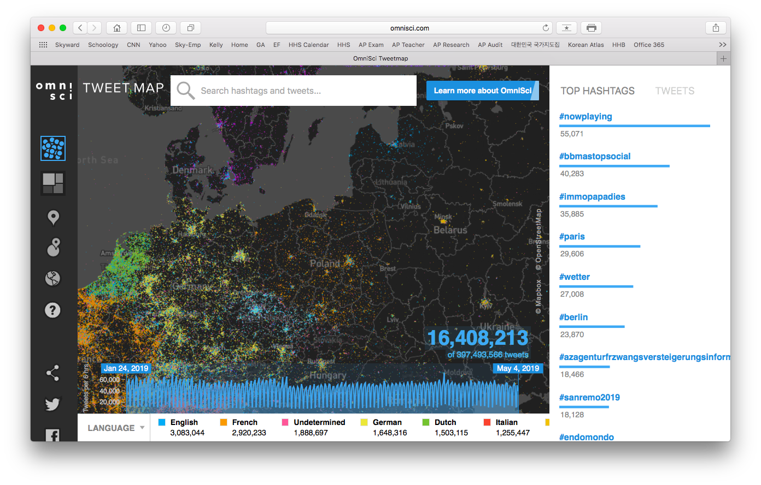

Slide 18
What is the language of the tweets on the world map?
Portuguese
Answer Choices…
Arabic
English
Japanese
Portuguese
Spanish
Tagalog
6

Slide 19
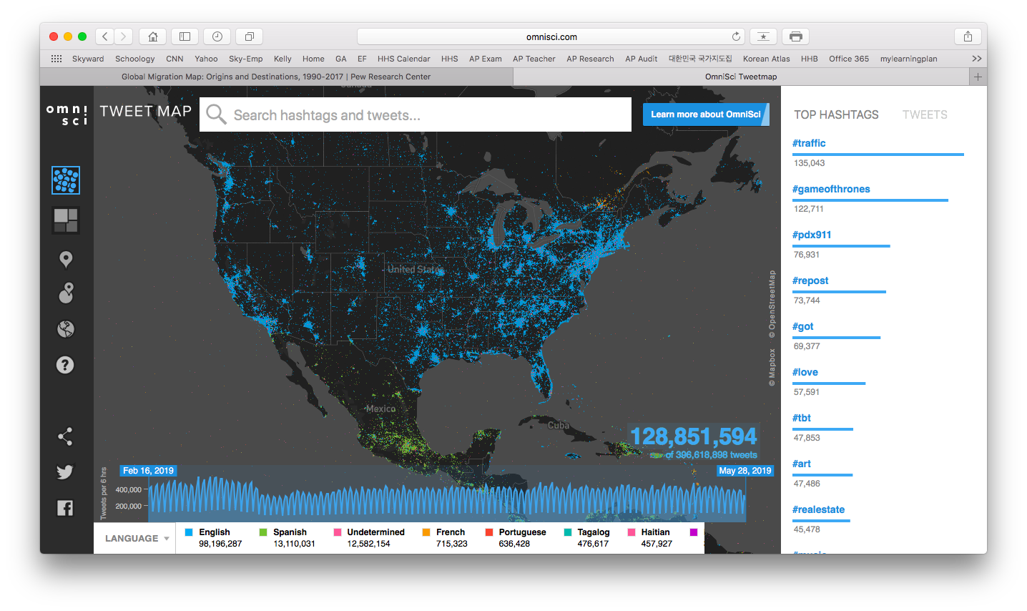
Tweeting in the
U.S.A.
Student Activity

Slide 20
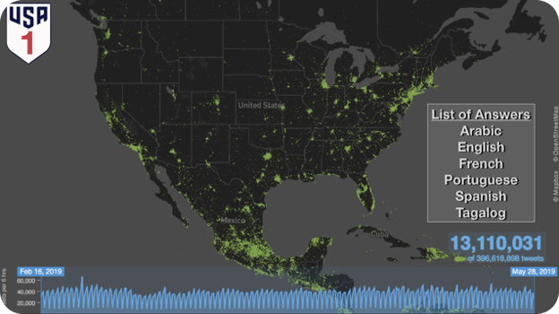
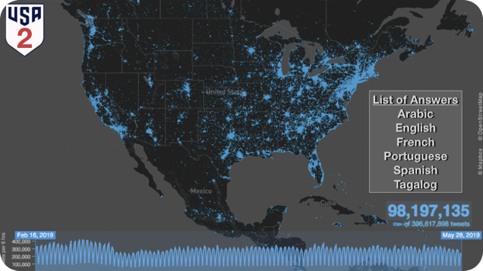
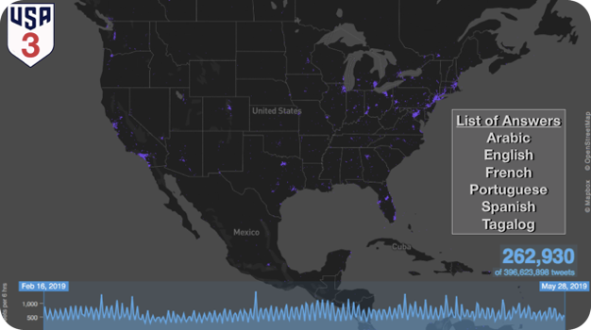
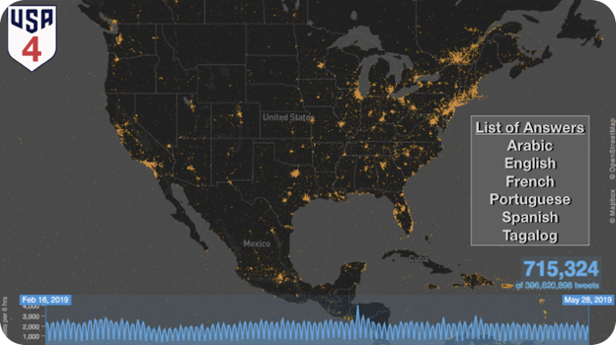
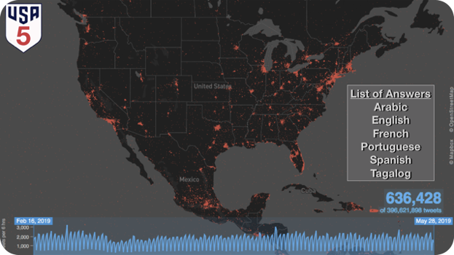
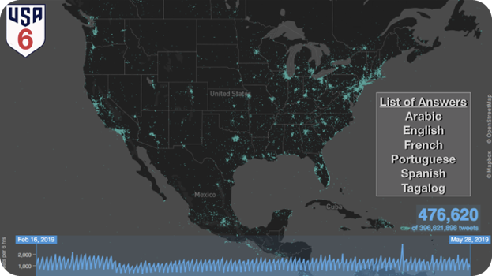
Tweeting in the U.S.A.
Student Activity

Slide 21
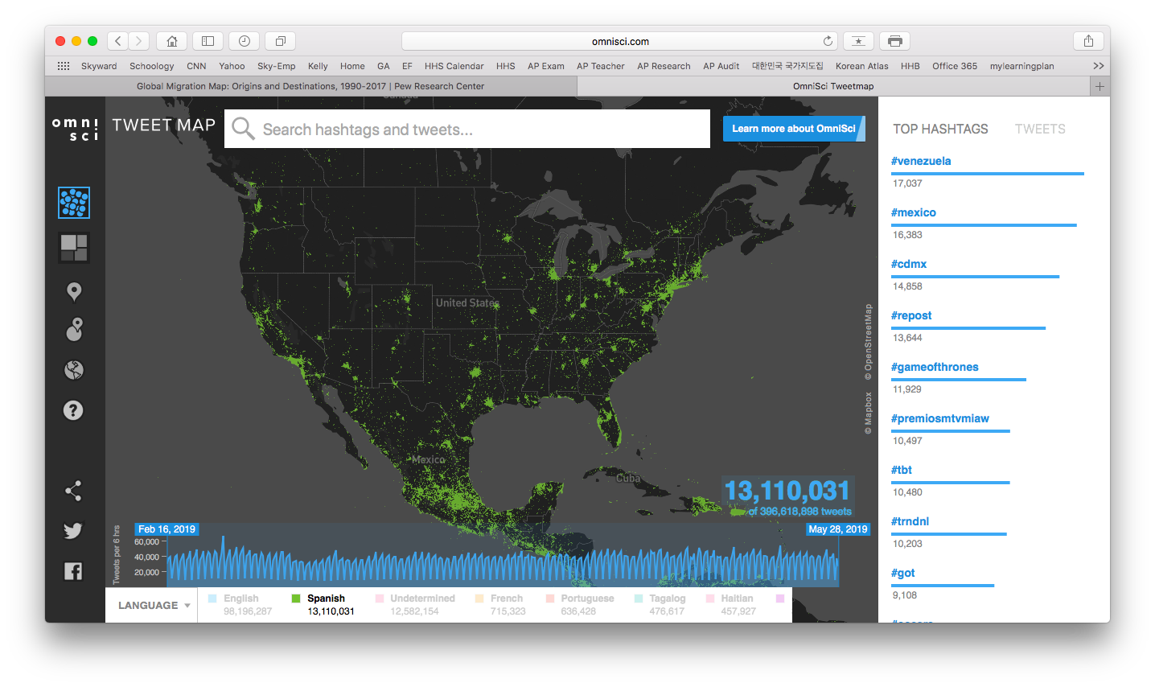
1
List of Answers
Arabic
English
French
Portuguese
Spanish
Tagalog

Slide 22
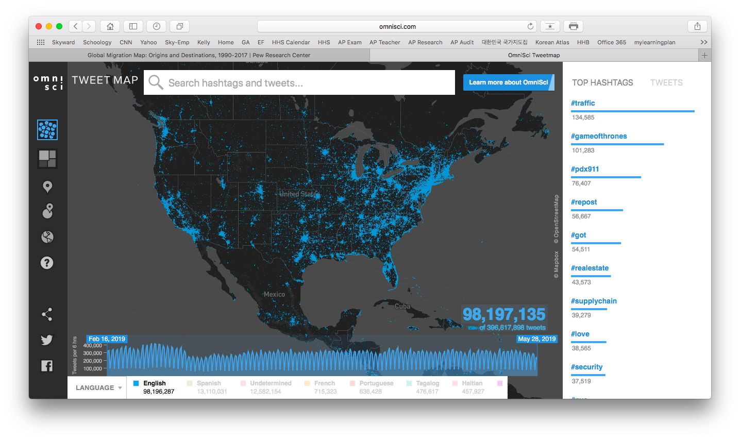
2
List of Answers
Arabic
English
French
Portuguese
Spanish
Tagalog

Slide 23
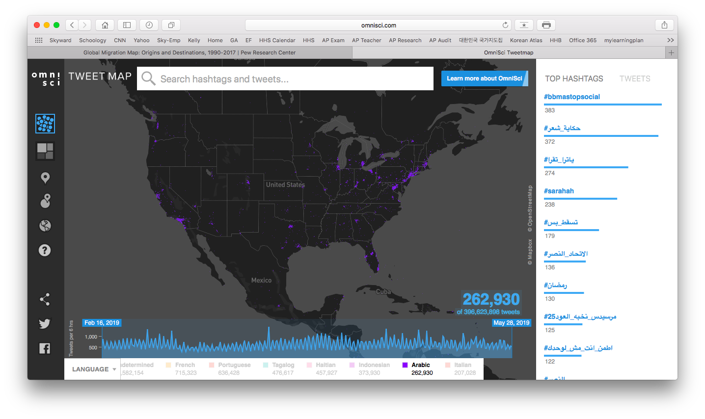
3
List of Answers
Arabic
English
French
Portuguese
Spanish
Tagalog

Slide 24
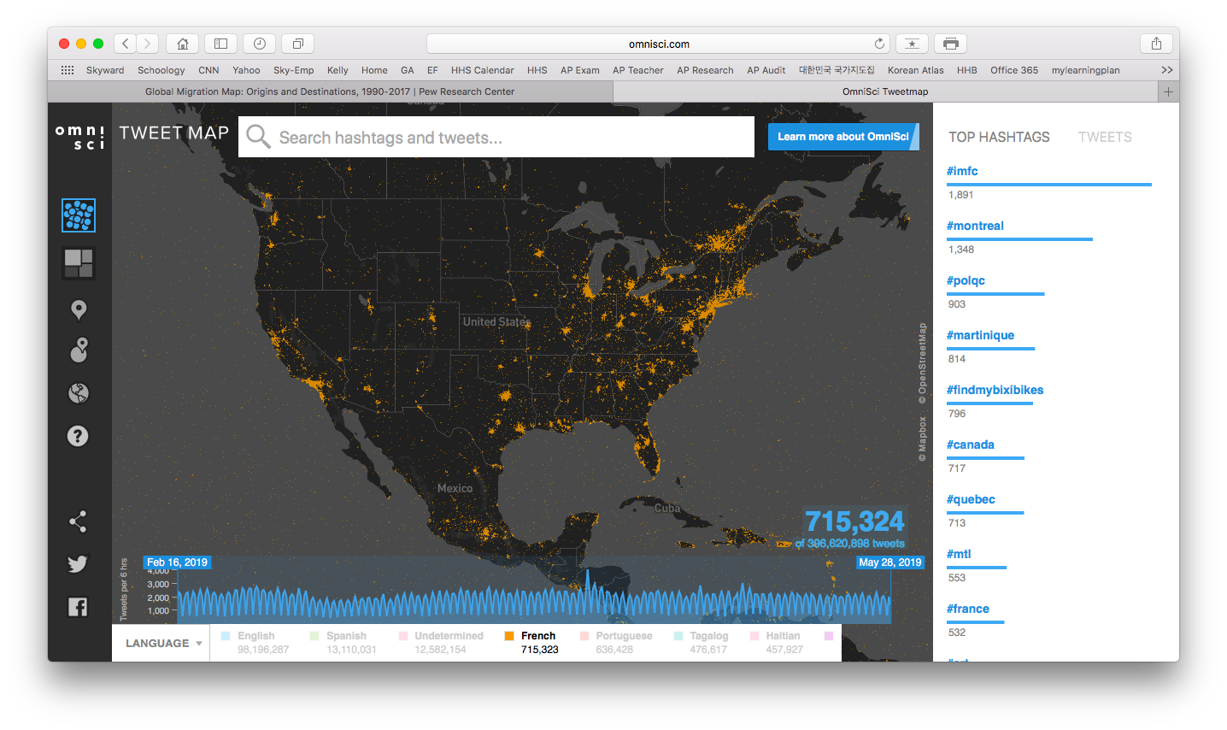
4
List of Answers
Arabic
English
French
Portuguese
Spanish
Tagalog

Slide 25
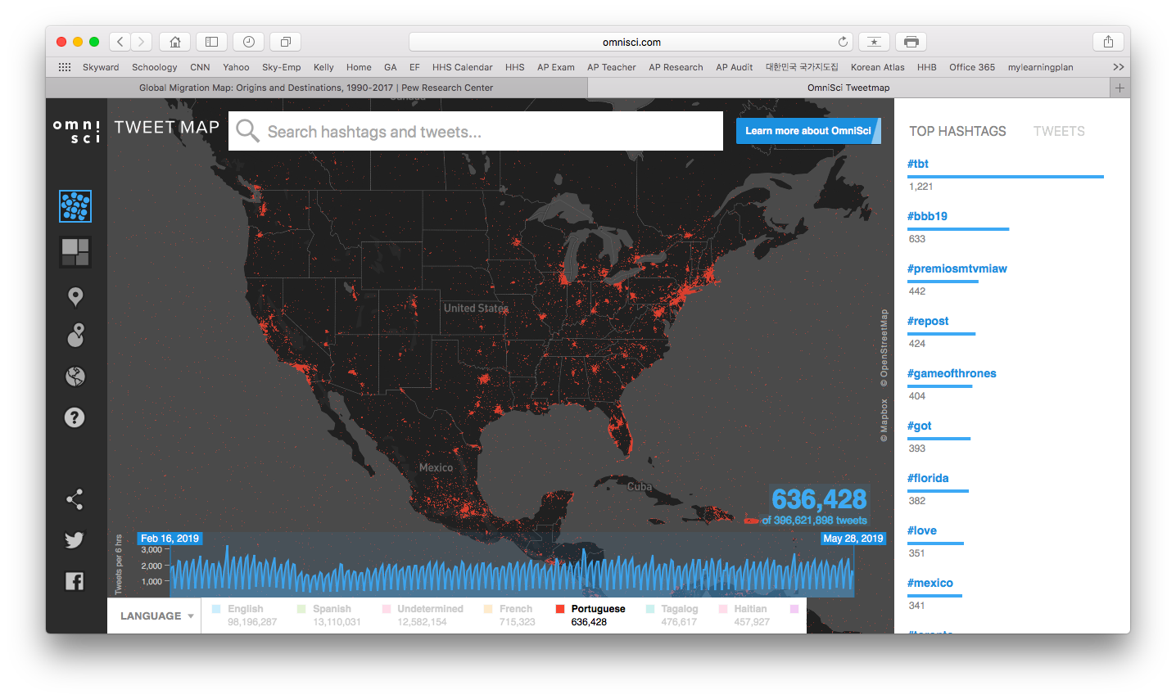
5
List of Answers
Arabic
English
French
Portuguese
Spanish
Tagalog

Slide 26
6
List of Answers
Arabic
English
French
Portuguese
Spanish
Tagalog

Slide 27
Tweeting in the U.S.A.
Student Activity

Slide 28
ANSWERS

Slide 29
1
List of Answers
Arabic
English
French
Portuguese
Spanish
Tagalog
Spanish

Slide 30
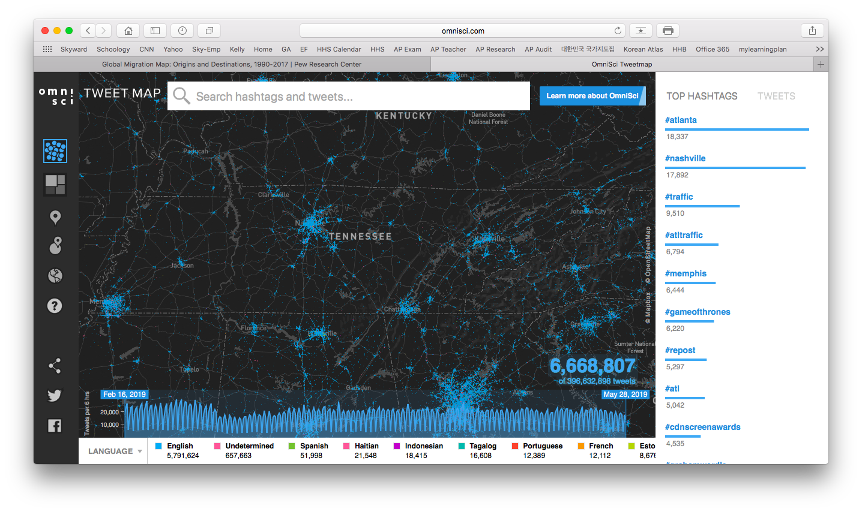

Slide 31
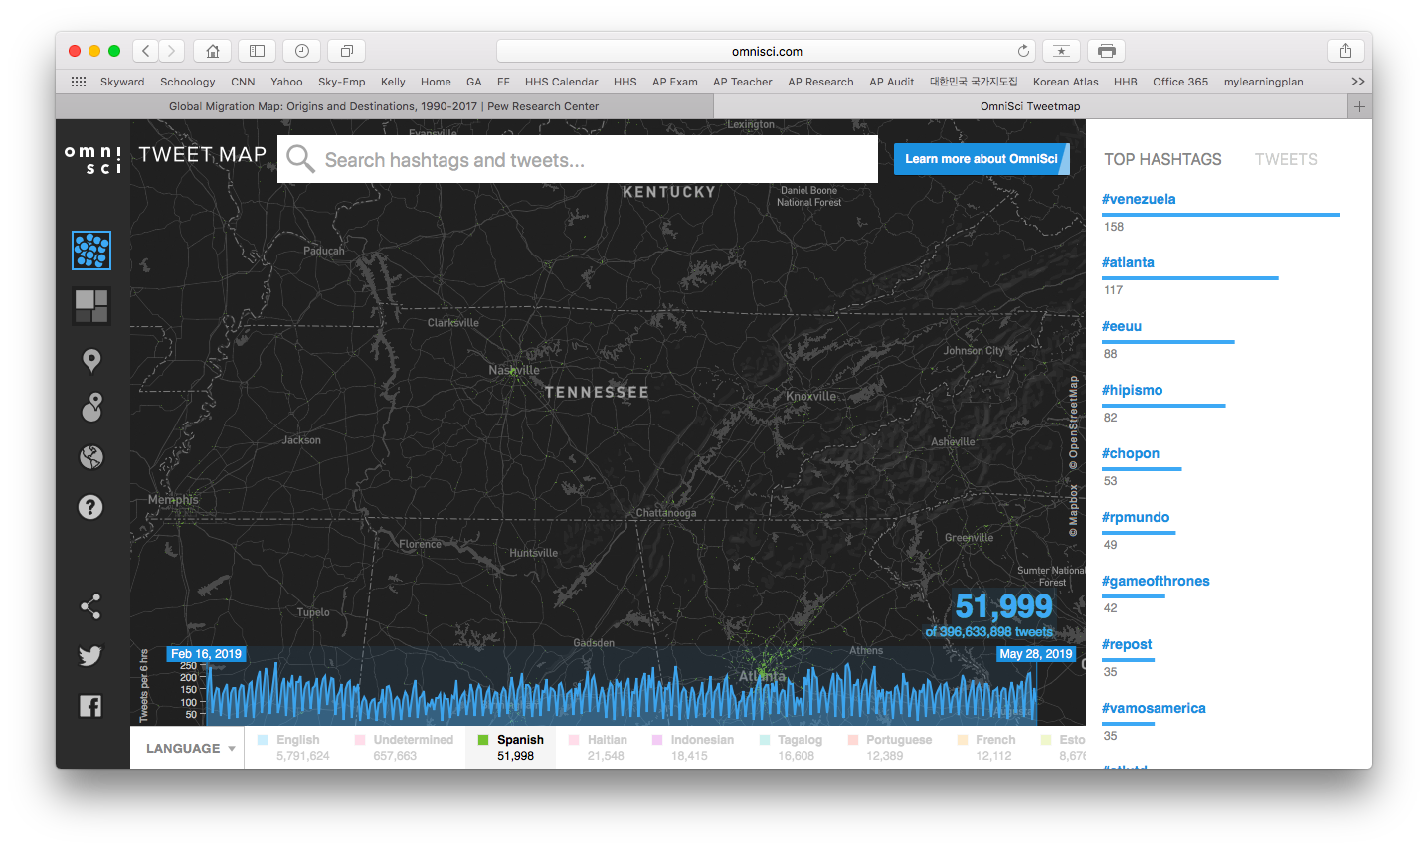

Slide 32
2
List of Answers
Arabic
English
French
Portuguese
Spanish
Tagalog
English

Slide 33
3
List of Answers
Arabic
English
French
Portuguese
Spanish
Tagalog
Arabic

Slide 34
4
List of Answers
Arabic
English
French
Portuguese
Spanish
Tagalog
French

Slide 35
5
List of Answers
Arabic
English
French
Portuguese
Spanish
Tagalog
Portuguese

Slide 36
6
List of Answers
Arabic
English
French
Portuguese
Spanish
Tagalog
Tagalog

Slide 37
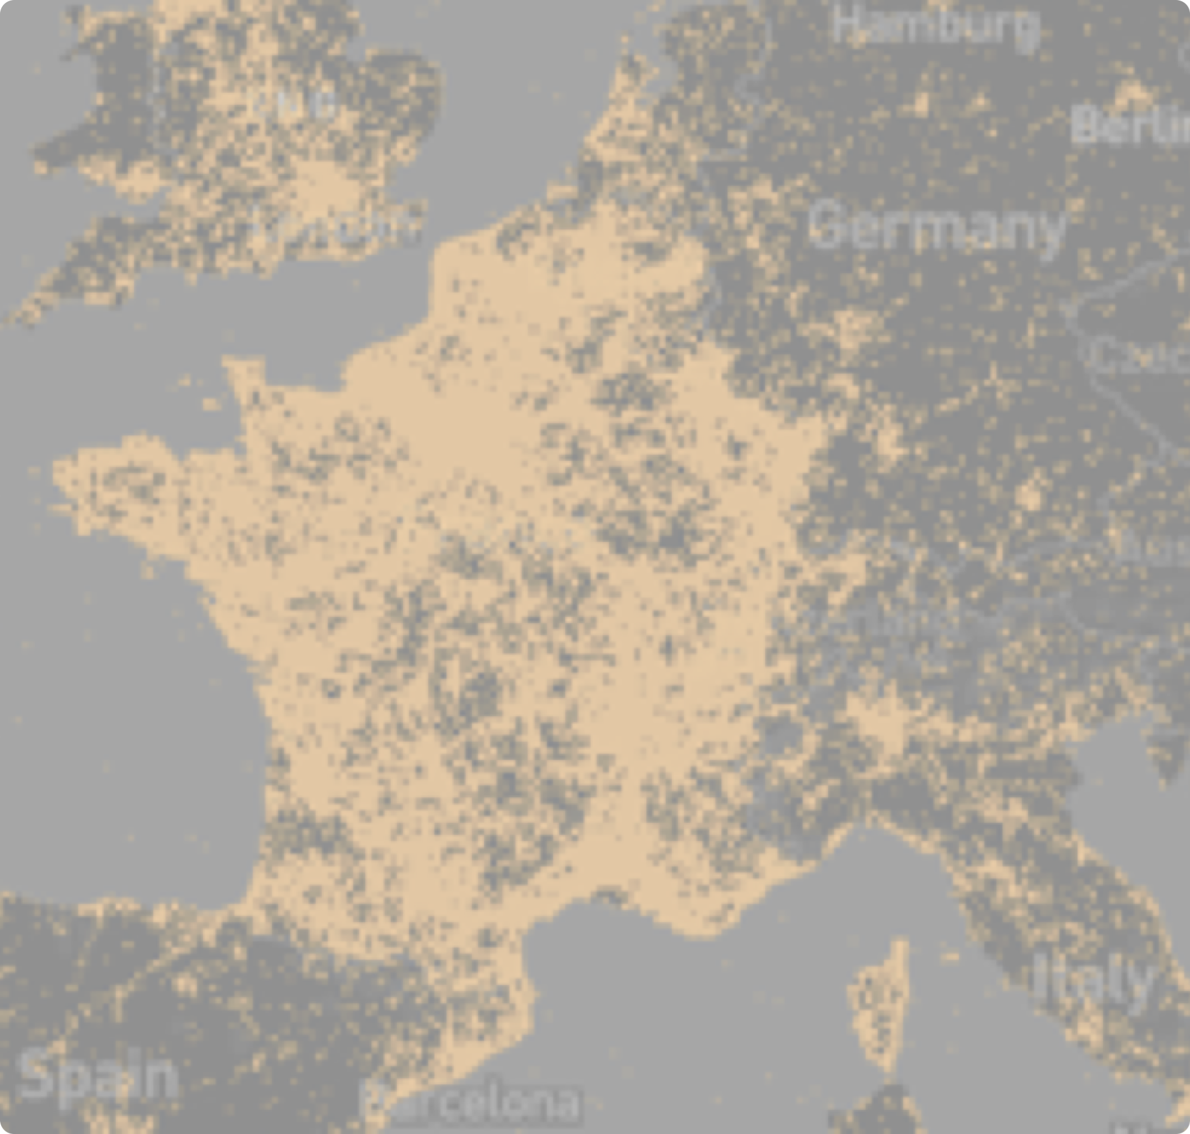
Tweeting in
Europe
Student Activity

Slide 38
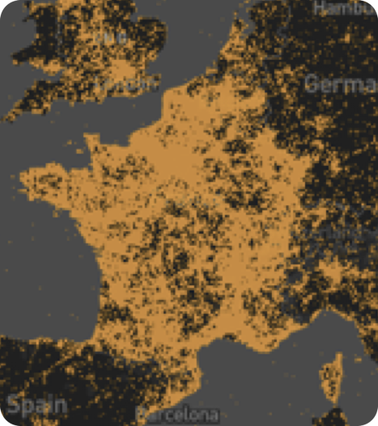
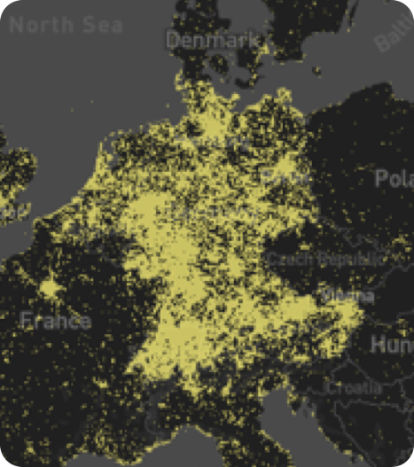
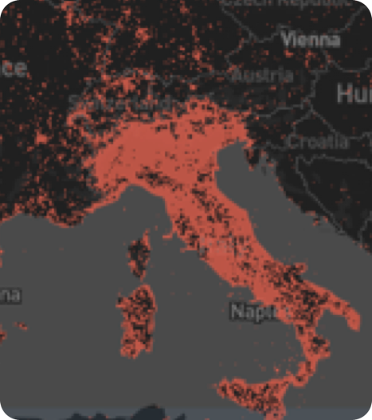
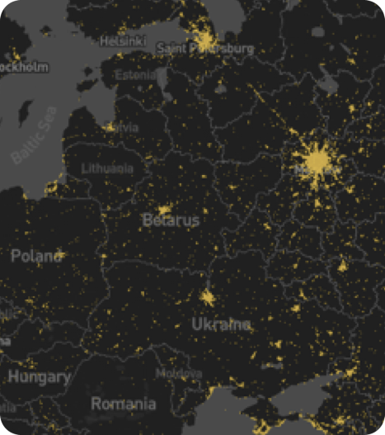
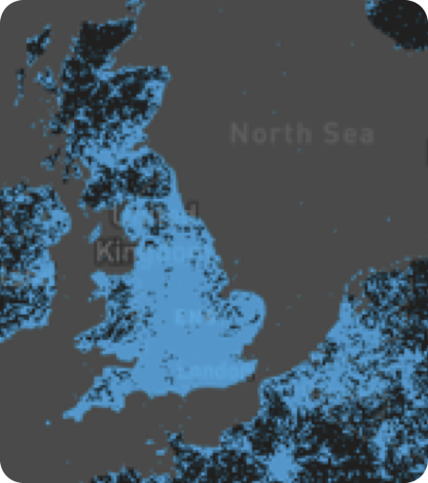
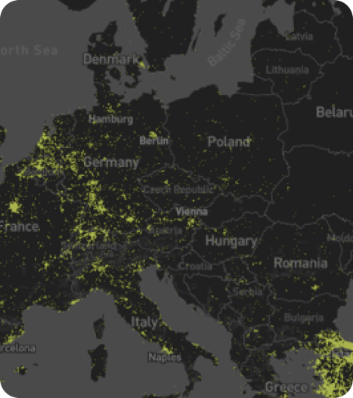
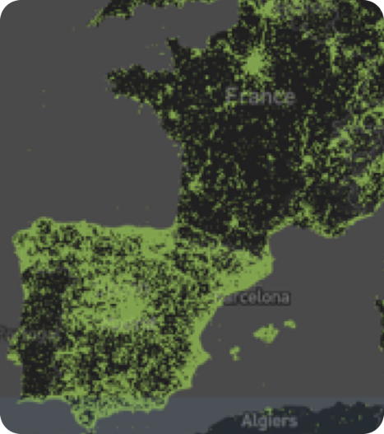

Slide 39
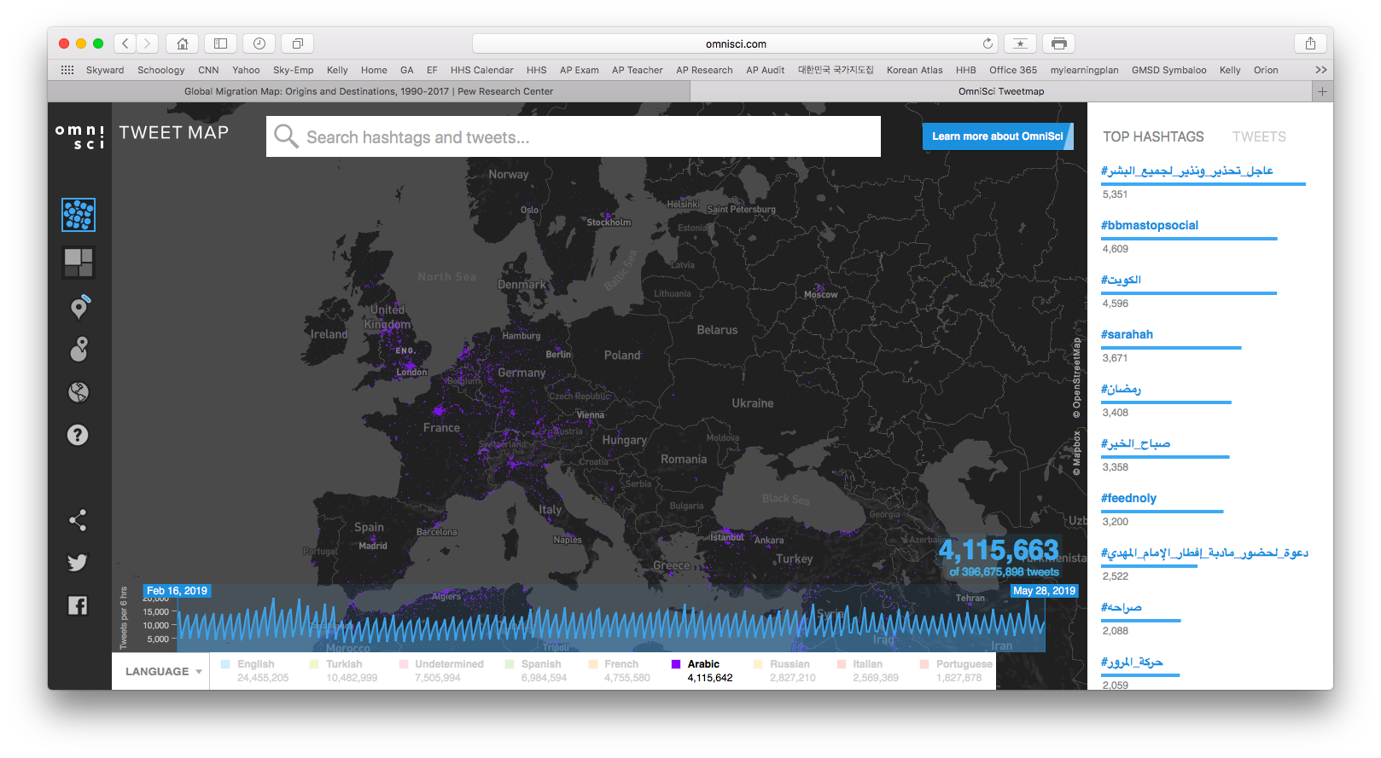
1
Answer Choices…
Arabic
English
French
German
Italian
Russian
Spanish
Turkish

Slide 40
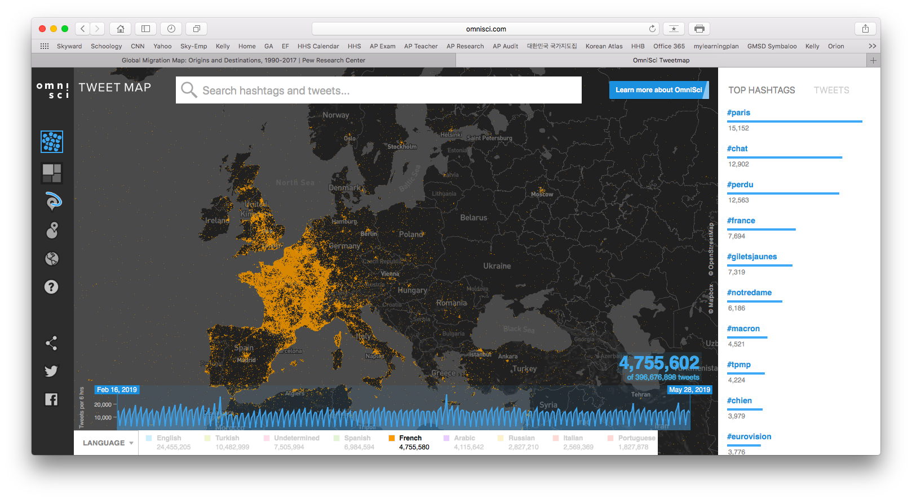
2
Answer Choices…
Arabic
English
French
German
Italian
Russian
Spanish
Turkish

Slide 41
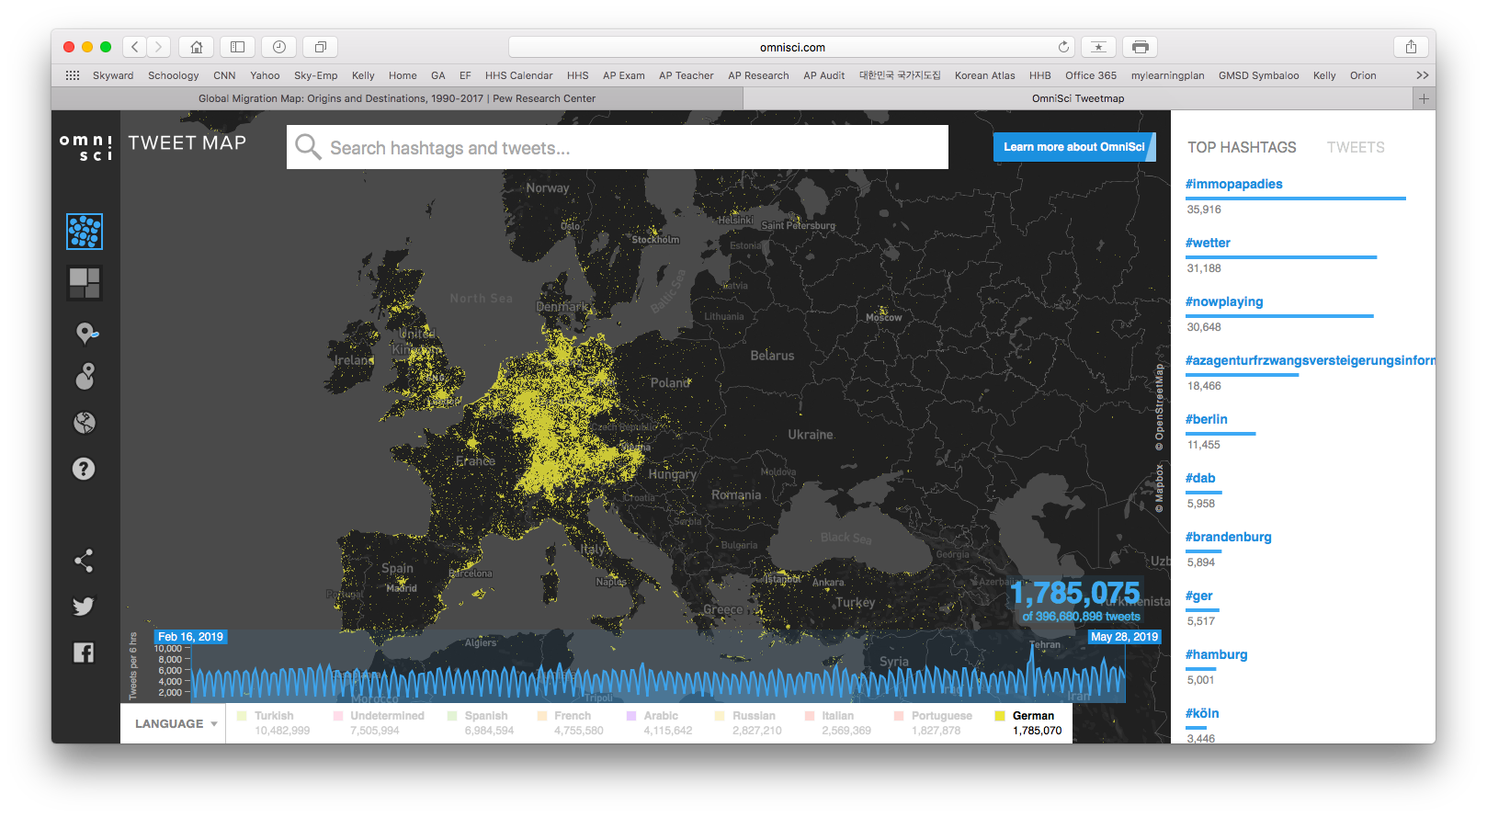
3
Answer Choices…
Arabic
English
French
German
Italian
Russian
Spanish
Turkish

Slide 42
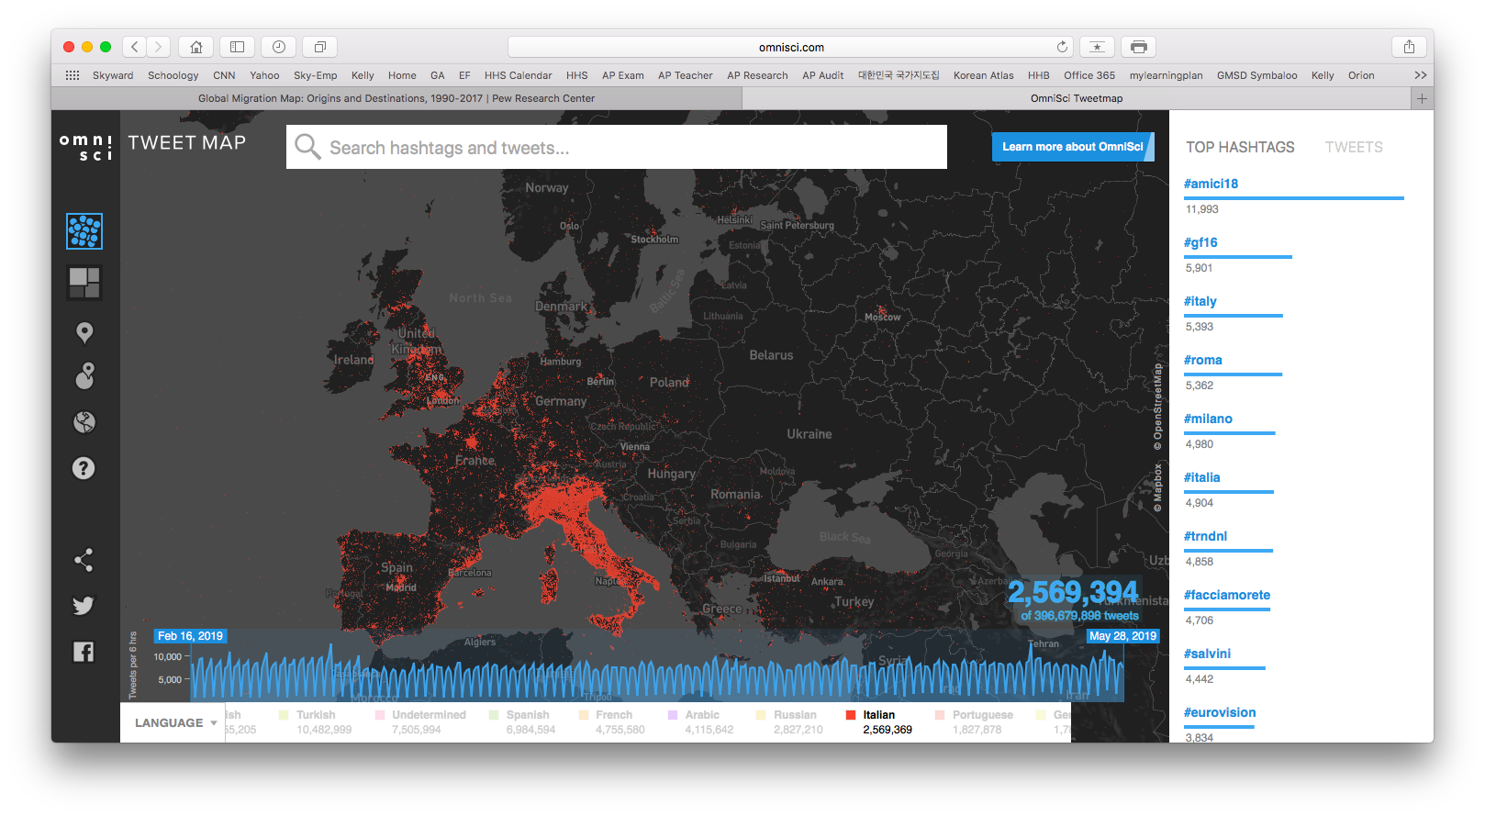
4
Answer Choices…
Arabic
English
French
German
Italian
Russian
Spanish
Turkish

Slide 43
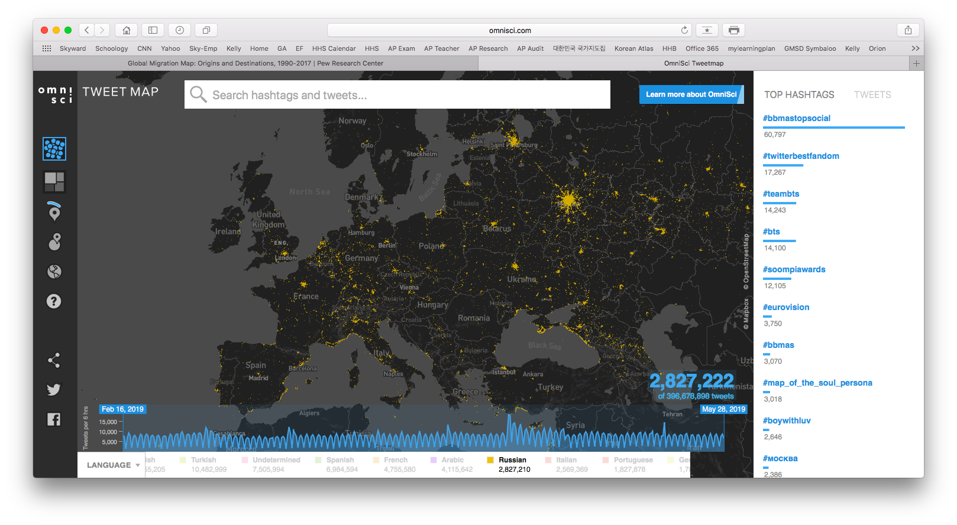
5
Answer Choices…
Arabic
English
French
German
Italian
Russian
Spanish
Turkish

Slide 44
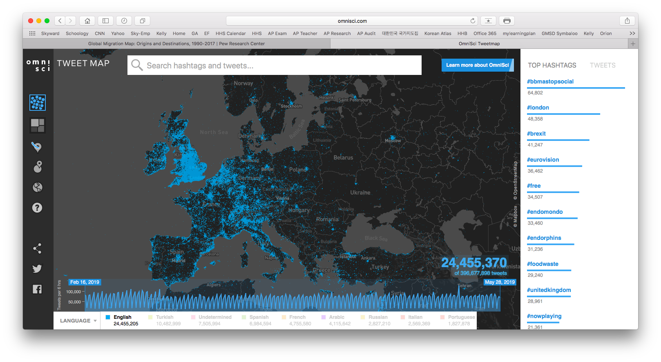
6
Answer Choices…
Arabic
English
French
German
Italian
Russian
Spanish
Turkish

Slide 45
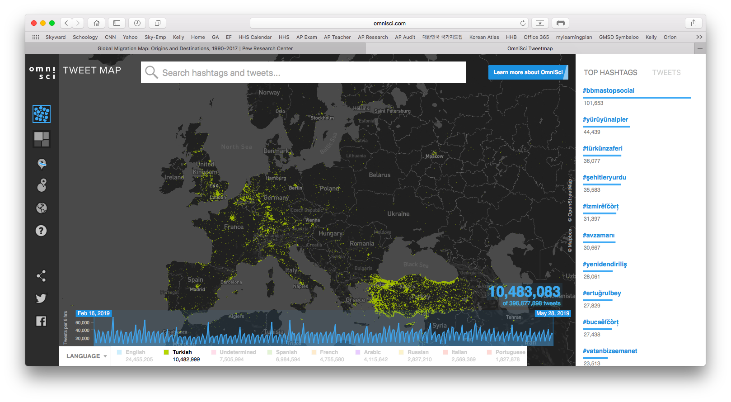
7
Answer Choices…
Arabic
English
French
German
Italian
Russian
Spanish
Turkish

Slide 46
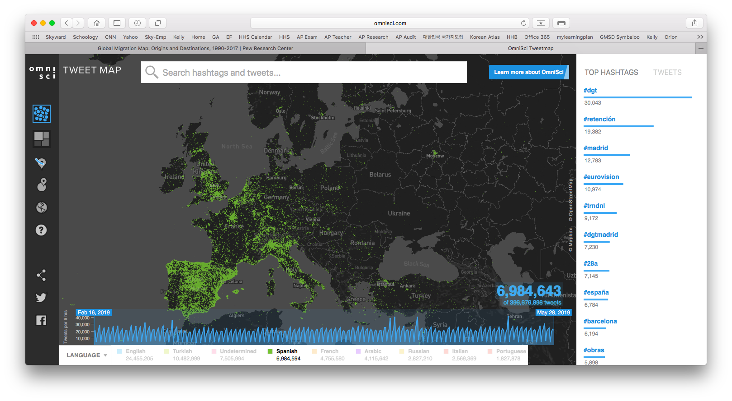
8
Answer Choices…
Arabic
English
French
German
Italian
Russian
Spanish
Turkish

Slide 48
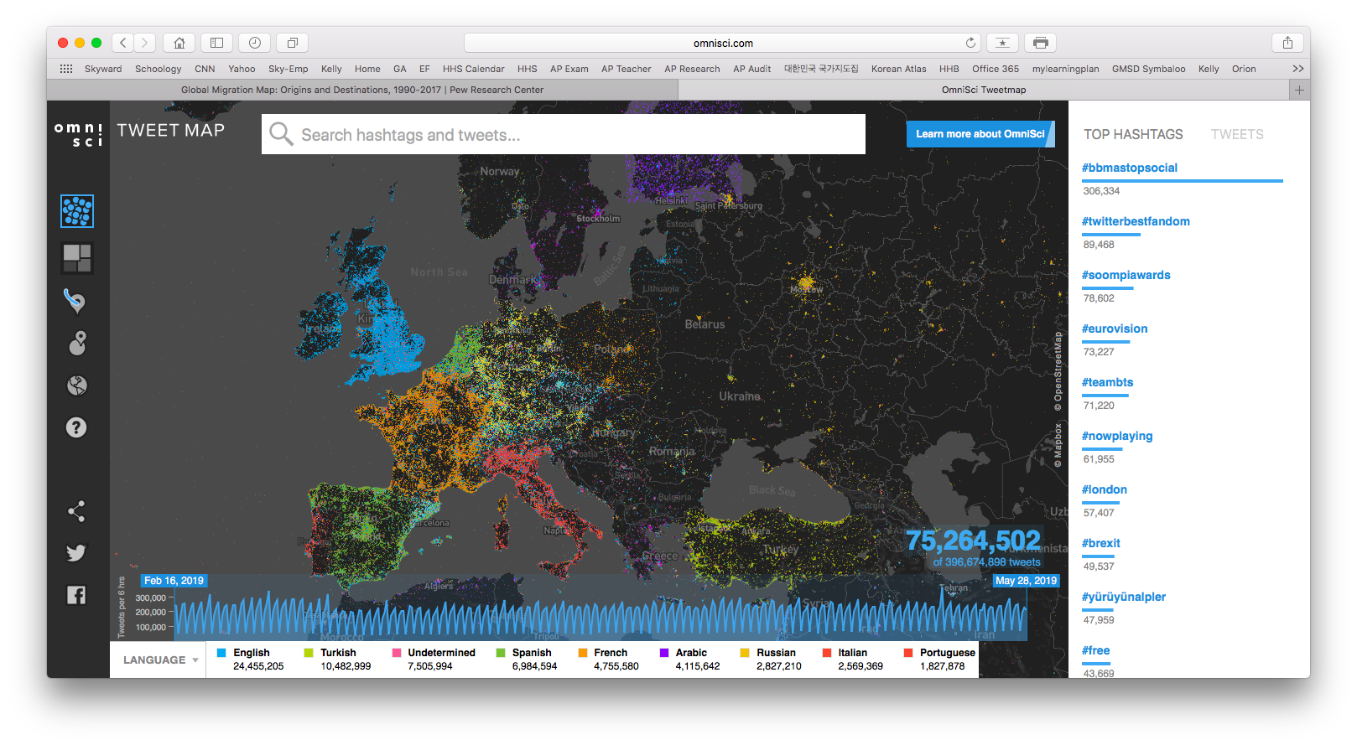
ANSWERS

Slide 49
1
Arabic
Answer Choices…
Arabic
English
French
German
Italian
Russian
Spanish
Turkish

Slide 50
2
French
Answer Choices…
Arabic
English
French
German
Italian
Russian
Spanish
Turkish

Slide 51
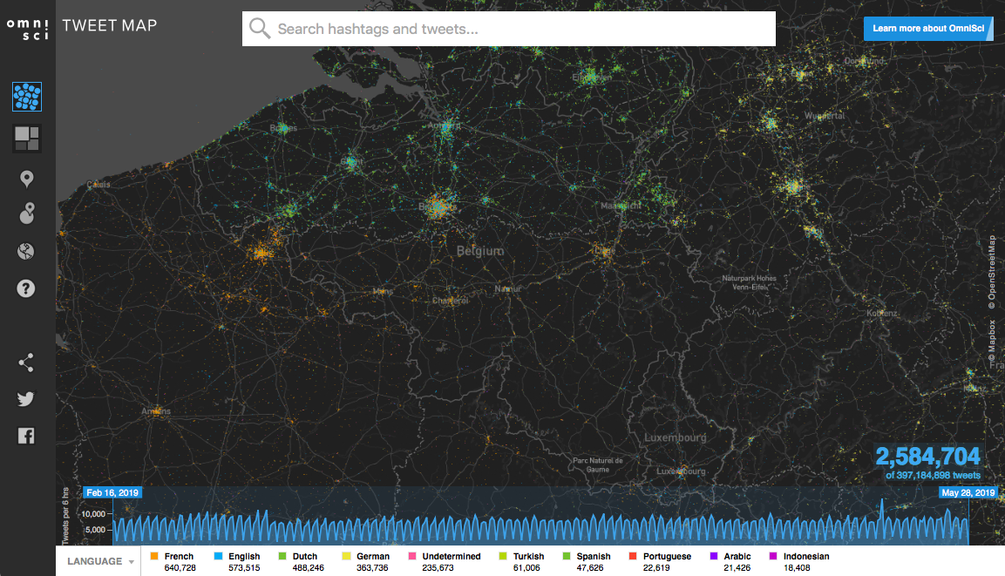

Slide 52
3
German
Answer Choices…
Arabic
English
French
German
Italian
Russian
Spanish
Turkish

Slide 53
4
Italian
Answer Choices…
Arabic
English
French
German
Italian
Russian
Spanish
Turkish

Slide 54
5
Russian
Answer Choices…
Arabic
English
French
German
Italian
Russian
Spanish
Turkish

Slide 55
6
English
Answer Choices…
Arabic
English
French
German
Italian
Russian
Spanish
Turkish

Slide 57
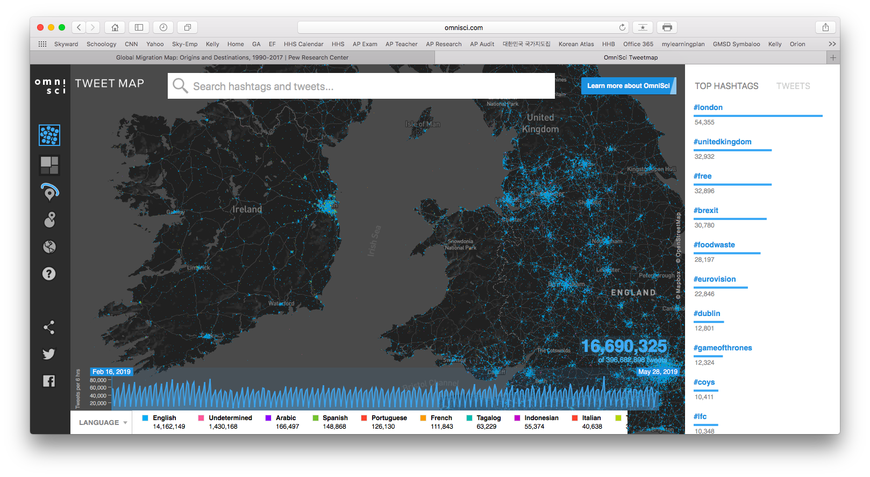

Slide 58
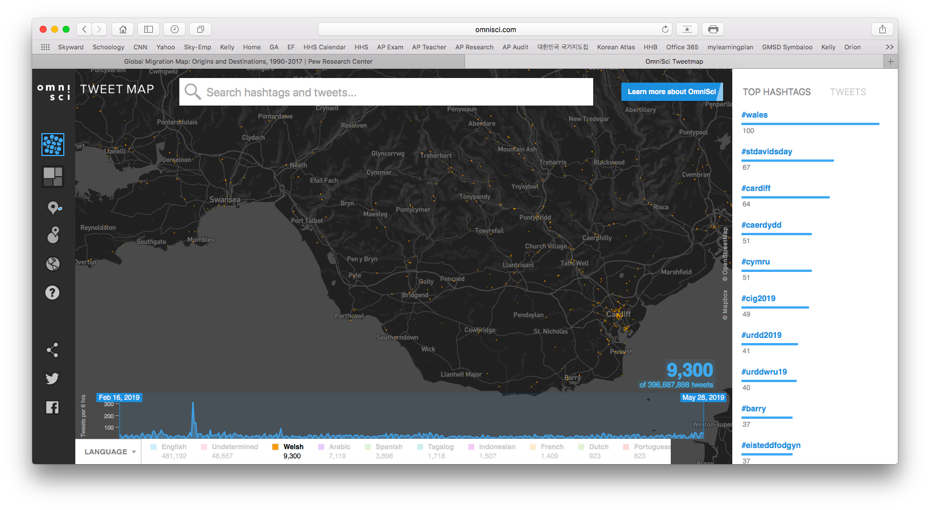

Slide 59
7
Turkish
Answer Choices…
Arabic
English
French
German
Italian
Russian
Spanish
Turkish

Slide 60
TWEETING
LANGUAGES of Europe

Slide 61
Since Twitter was founded in 2006 it has grown into a major social media network used by millions of people around the world. The map of Europe shows the tweets of Europe by language.
(A) Explain which languages are mainly being tweeted in Belgium.
(B) Explain which languages are mainly being tweeted in Cyprus.
(C) Explain which languages are mainly being tweeted in Spain.
(D) Explain which languages are mainly being tweeted in Switzerland.
(E) Discuss one reason why Eastern Europe has less tweeting than Western Europe.
(F) Discuss one example of how the map can help illustrate the nation-state concept.
(G) Discuss one example of how the map does not illustrate the nation-state concept.

