Slide 1
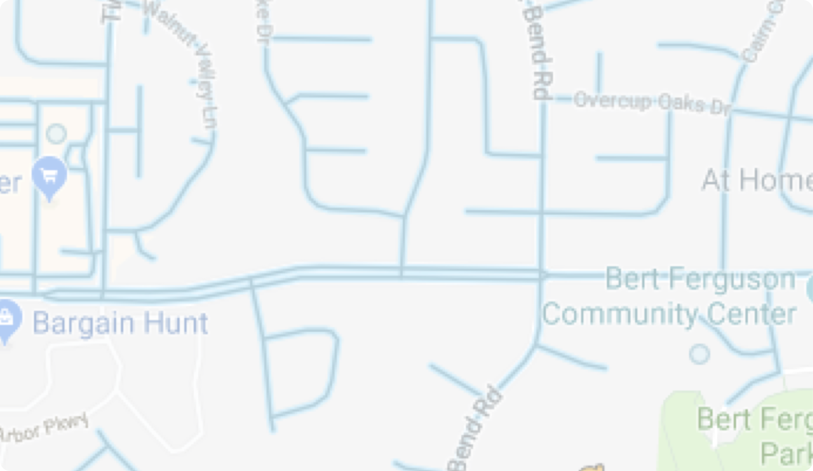
Unit Resources

Slide 2
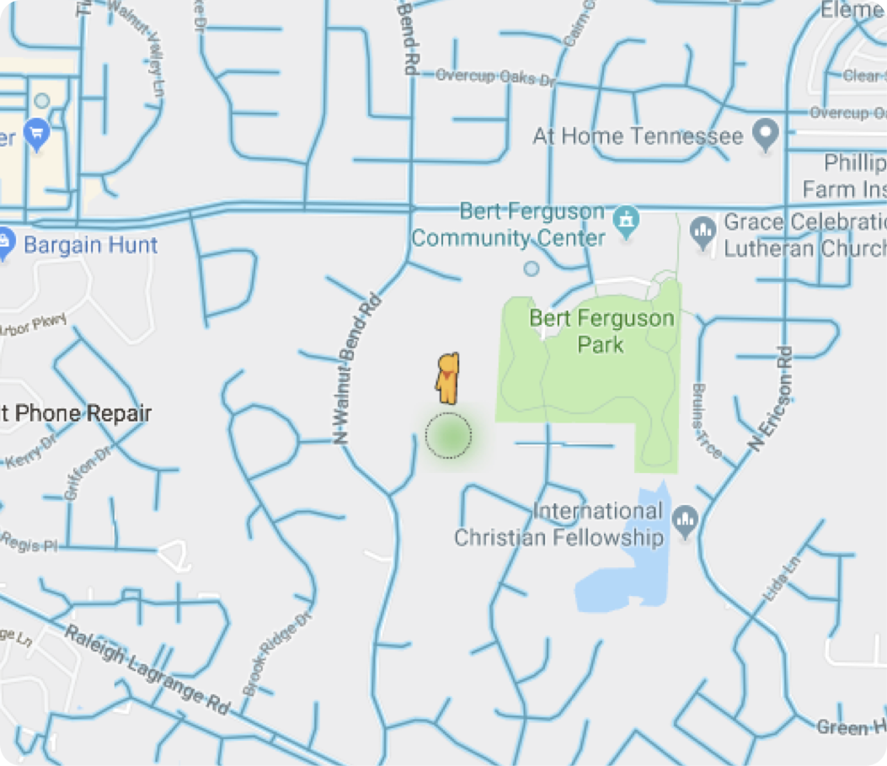
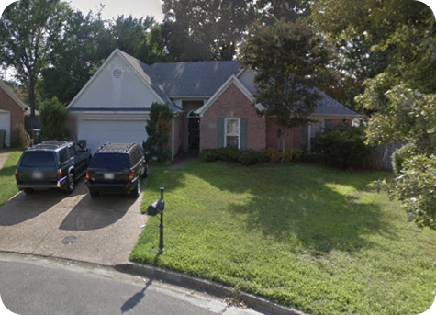
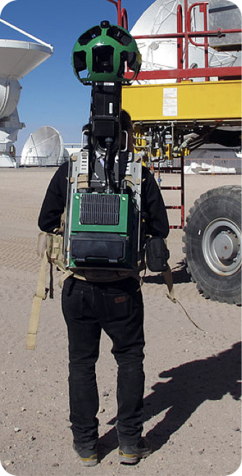
Resource for ALL Units

Slide 3
Google Street View

Slide 4
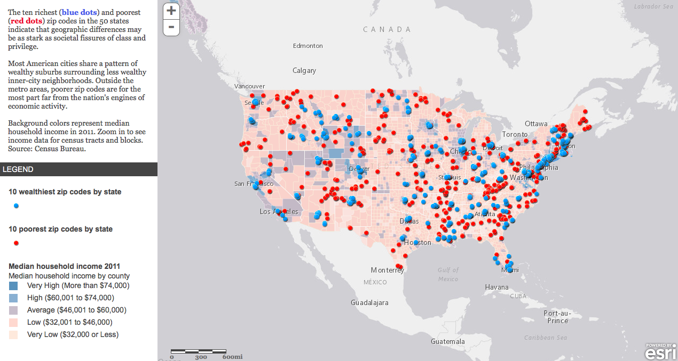
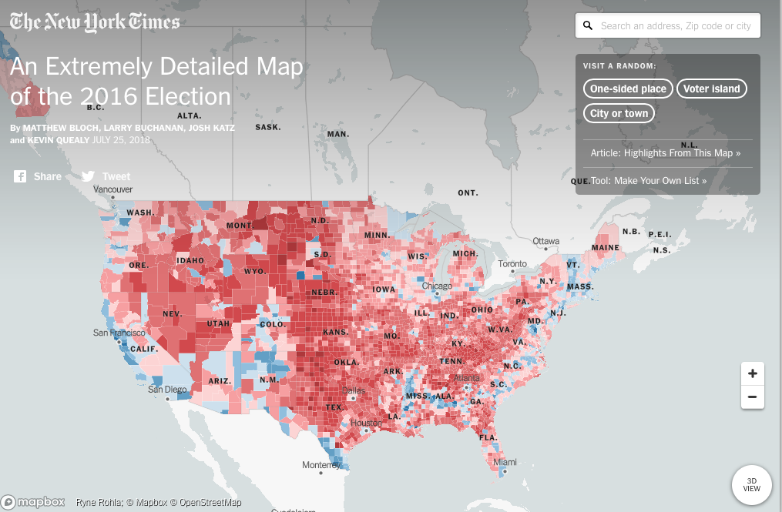
Thinking Geographically
http://storymaps.esri.com/stories/richpoor_embed/
Google the following:
“NYT An Extremely Detailed Map of 2016 Election”
https://www.nytimes.com/interactive/2018/upshot/election-2016-voting-precinct-maps.html?mtrref=www.google.com&gwh=8F01A2ABB01999A849AC0260103B52E6&gwt=pay

Slide 5
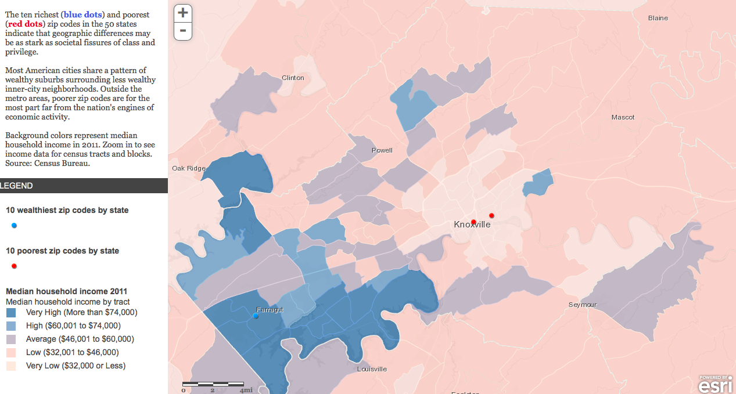

Slide 6
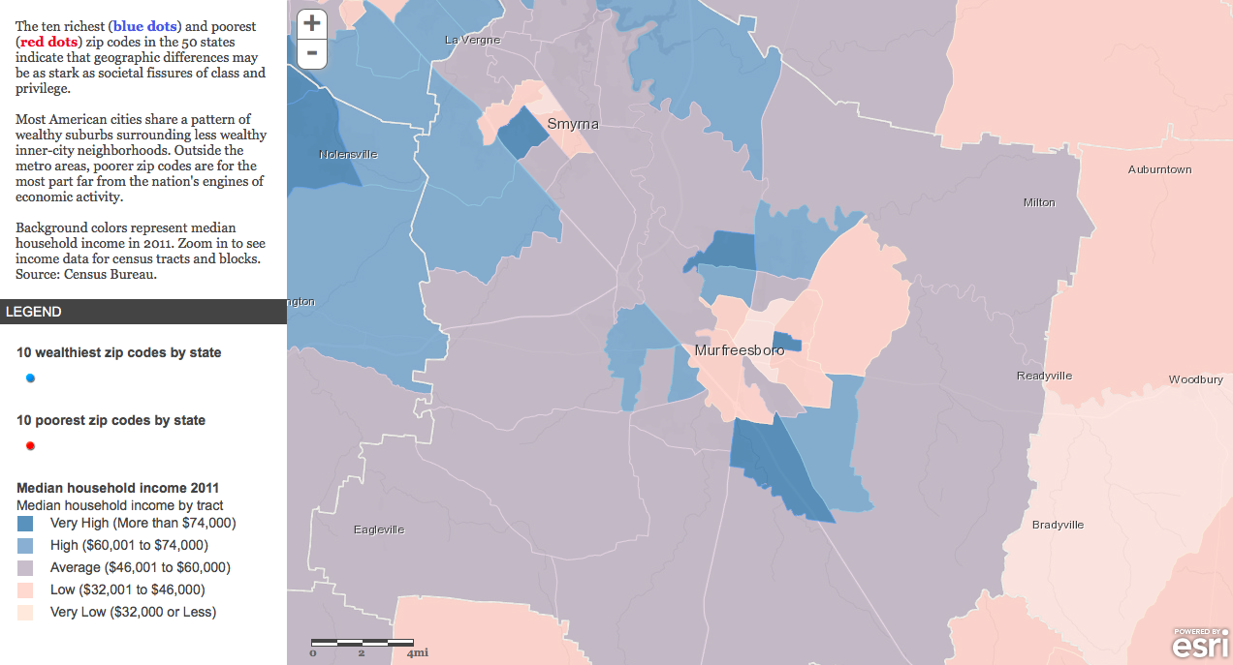

Slide 7
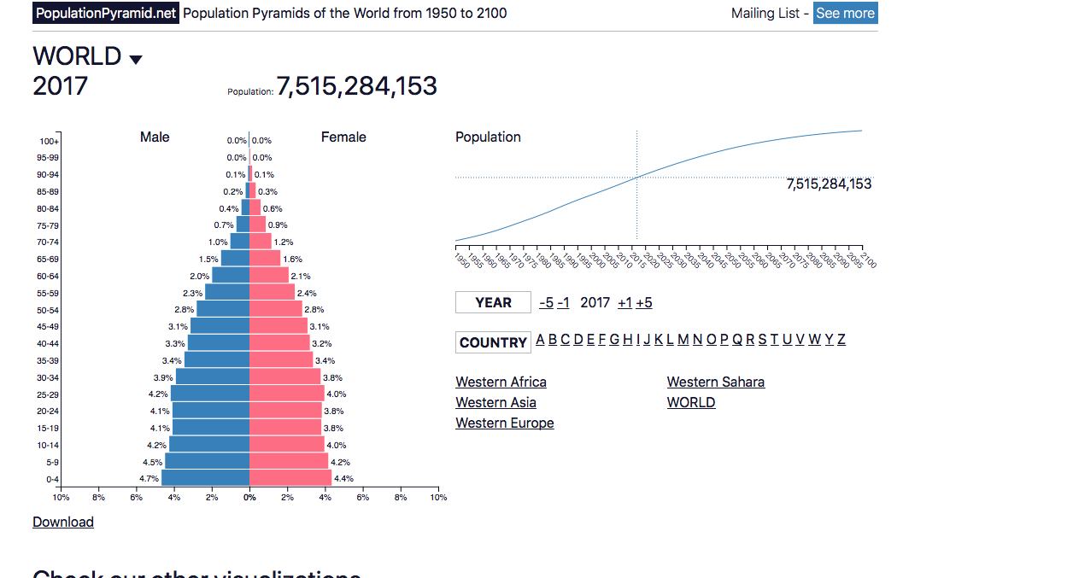
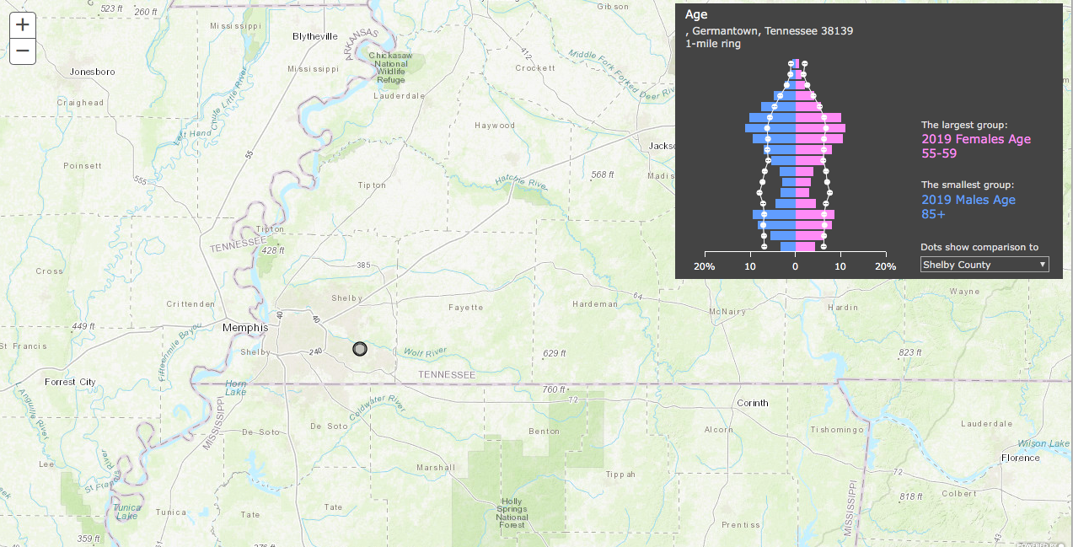
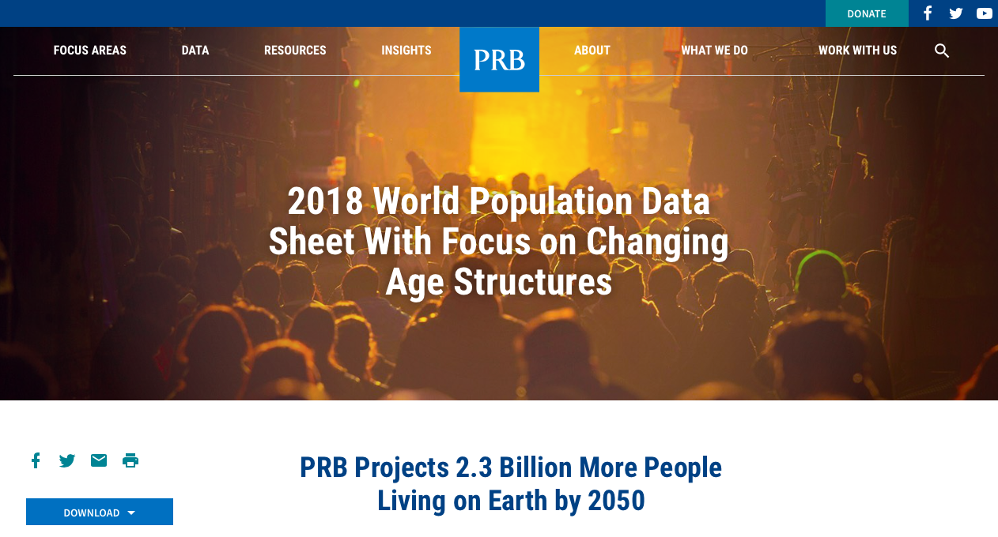
Population and Migration
Patterns and Processes
https://www.populationpyramid.net
https://developers.arcgis.com/javascript/3/samples/geoenrichment_infographic/
https://www.prb.org

Slide 8
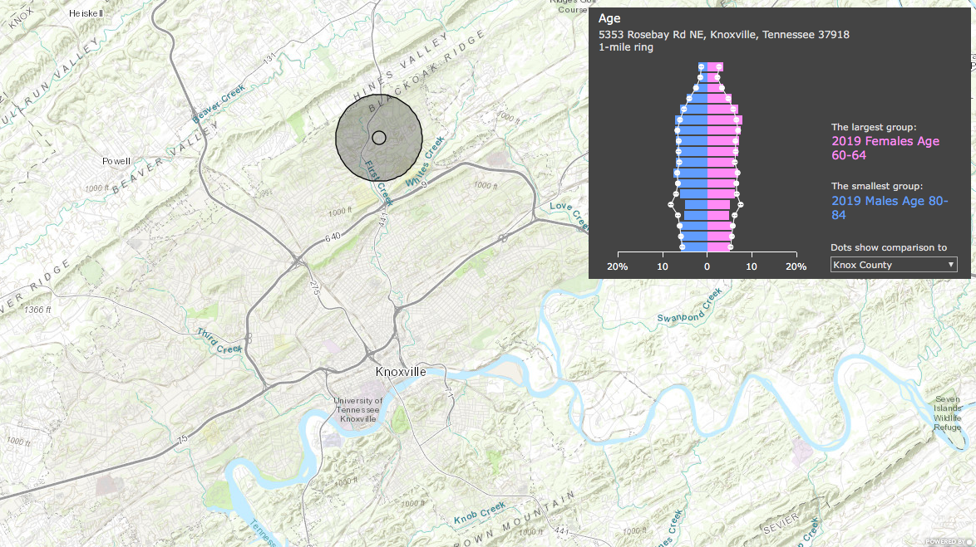

Slide 9
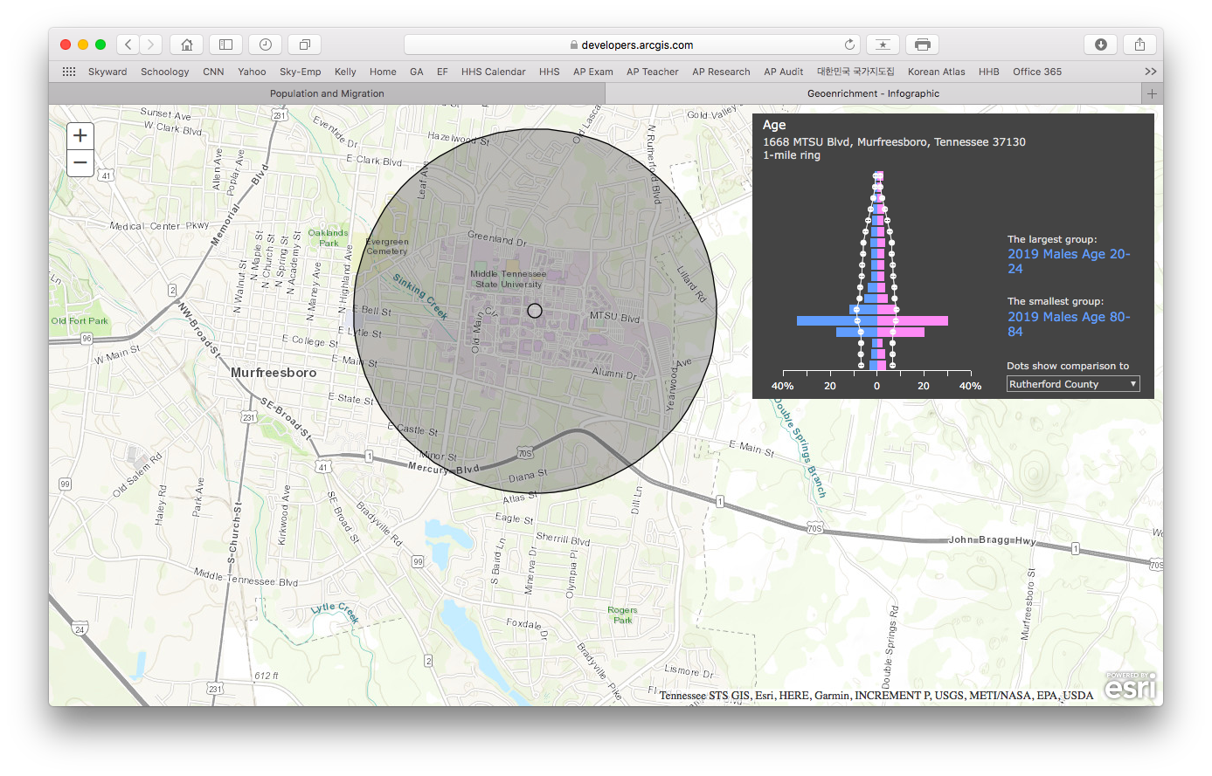

Slide 10
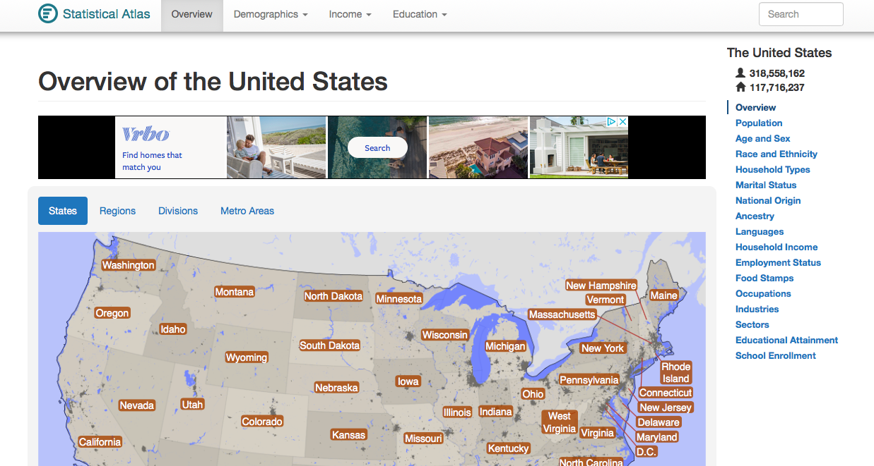
https://statisticalatlas.com/United-States/Overview

Slide 11
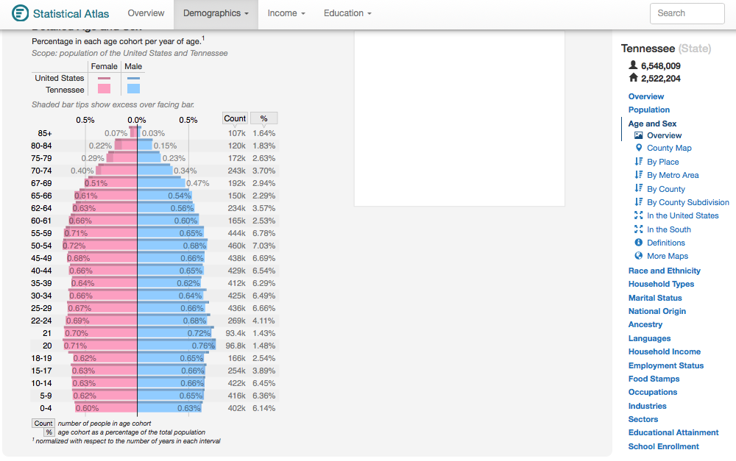
https://statisticalatlas.com/United-States/Overview

Slide 12
https://statisticalatlas.com/United-States/Overview

Slide 13
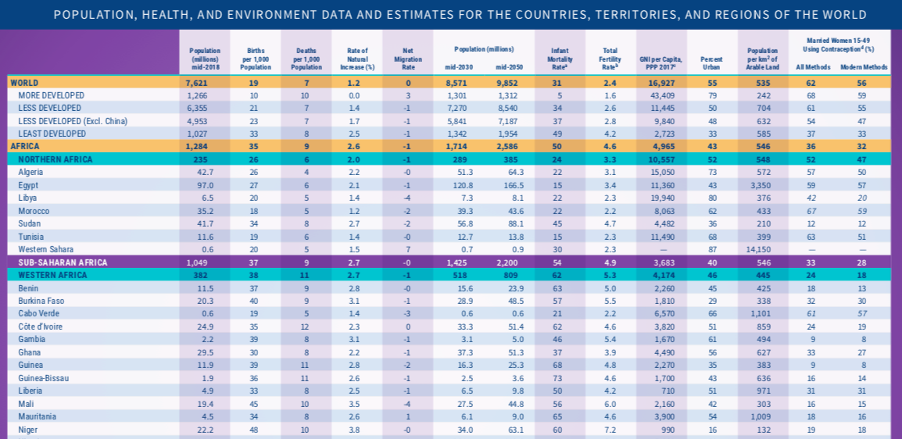
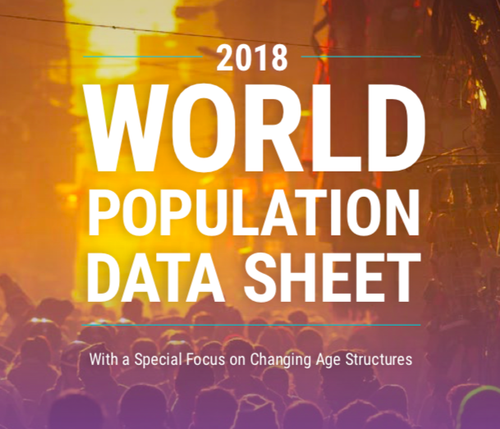
Population Reference Bureau

Slide 14
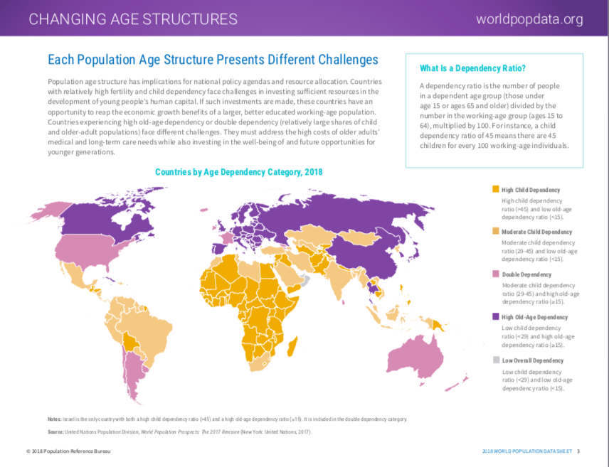

Slide 15
Cultural Patterns and Processes
https://www.ethnologue.com
https://www.pewresearch.org

Slide 16
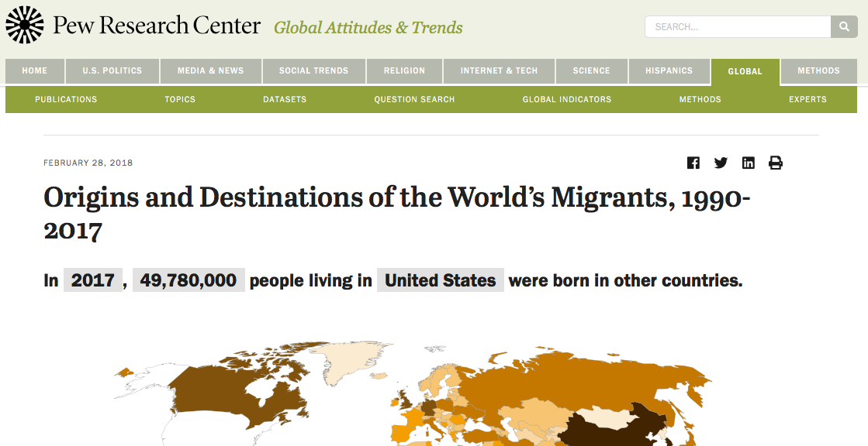
https://www.pewresearch.org

Slide 18
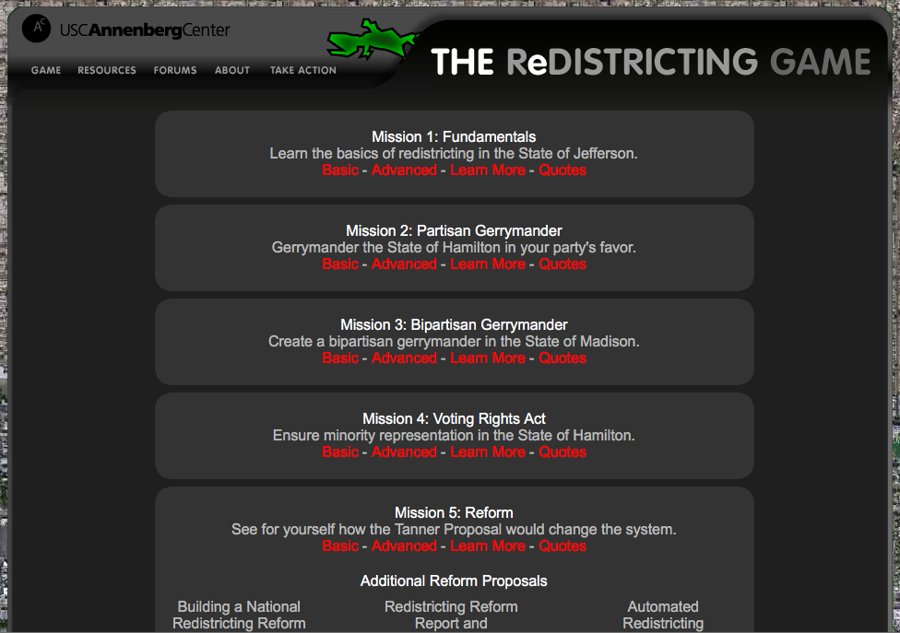
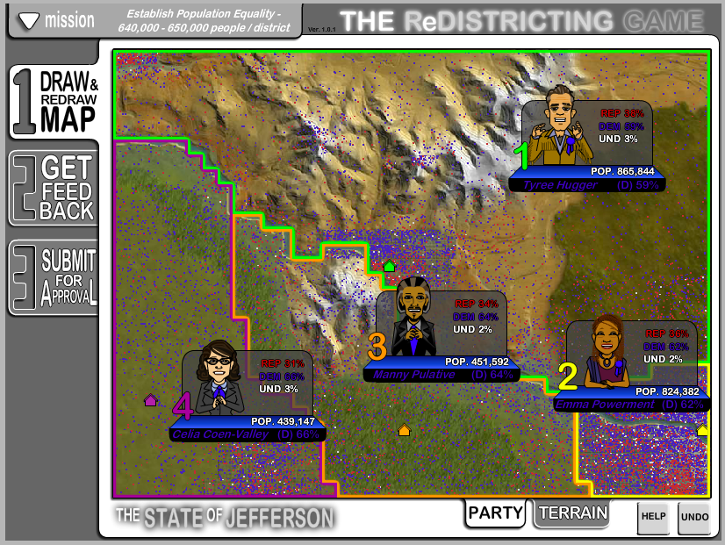
Political Patterns and Processes
https://www.vox.com/a/borders
https://www.facebook.com/pg/VoxBorders/videos/?ref=page_internal
https://www.youtube.com/watch?v=-dVwv4wPA88&list=PLJ8cMiYb3G5dRe4rC7m8jDaqodjZeLzCZ
redistrictinggame.org

Slide 19
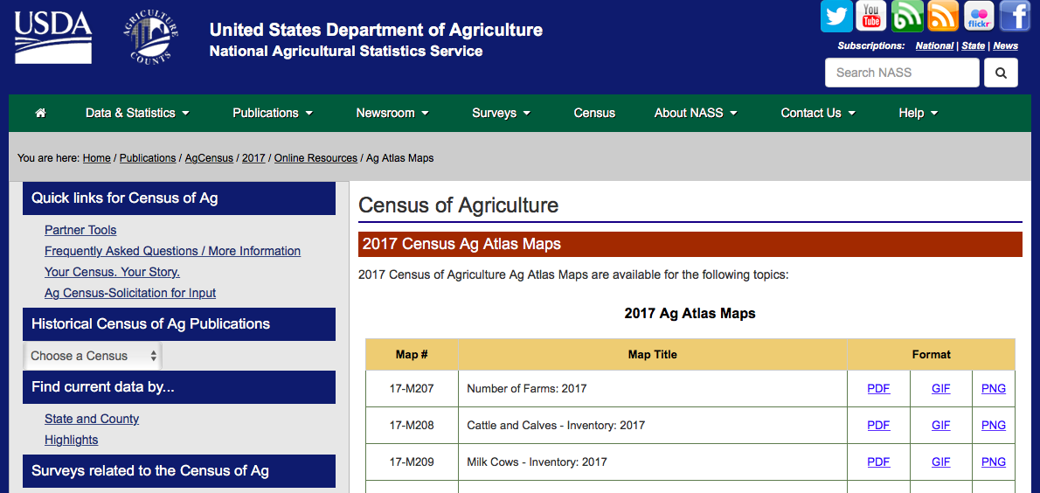
Agriculture and Rural Land-Use
Patterns and Processes
https://www.nass.usda.gov/Publications/AgCensus/2017/Online_Resources/Ag_Atlas_Maps/
https://www.vox.com/2014/11/3/18092700/what-is-genetically-modified-food

Slide 20
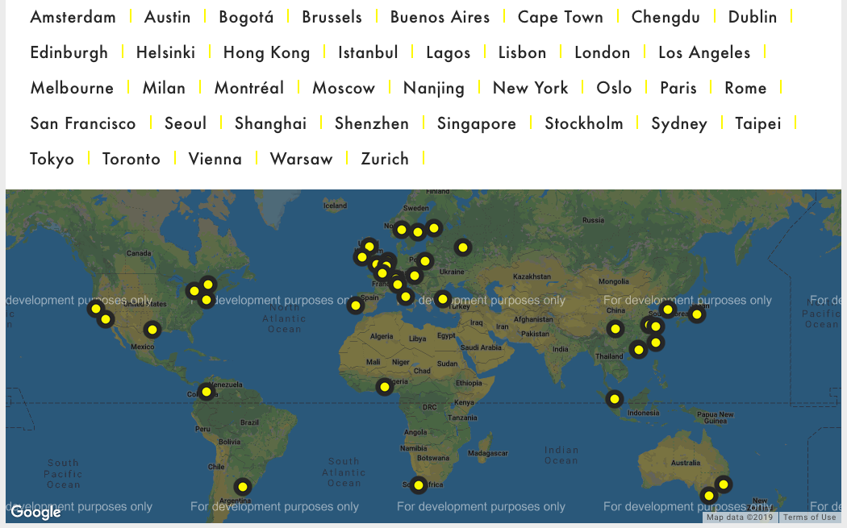
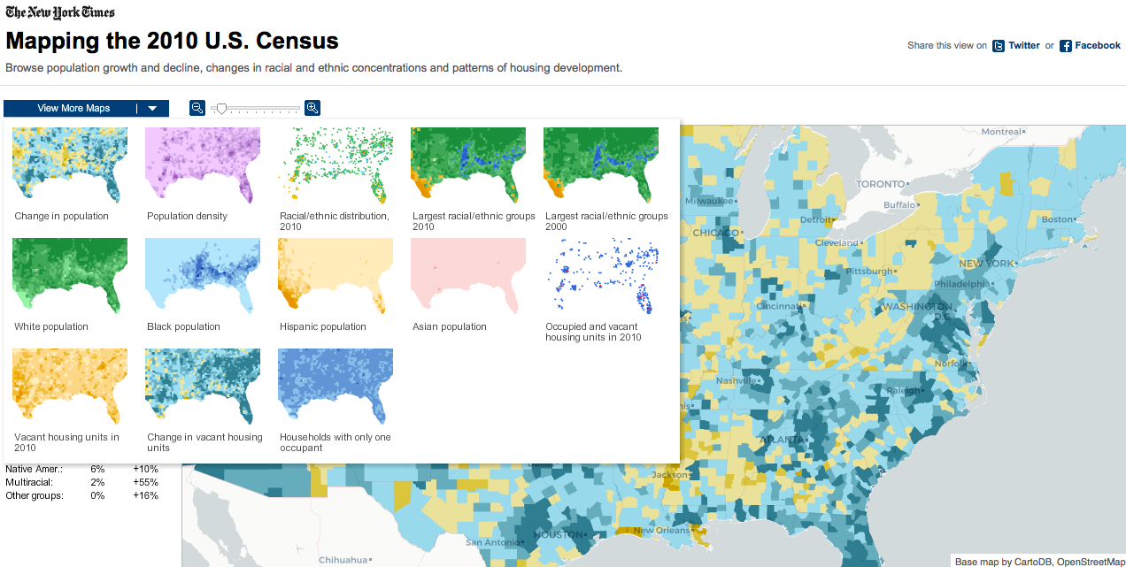
Cities and Urban Land
Patterns and Processes
http://www.worldcitiescultureforum.com
http://www.nytimes.com/projects/census/2010/map.html

Slide 21
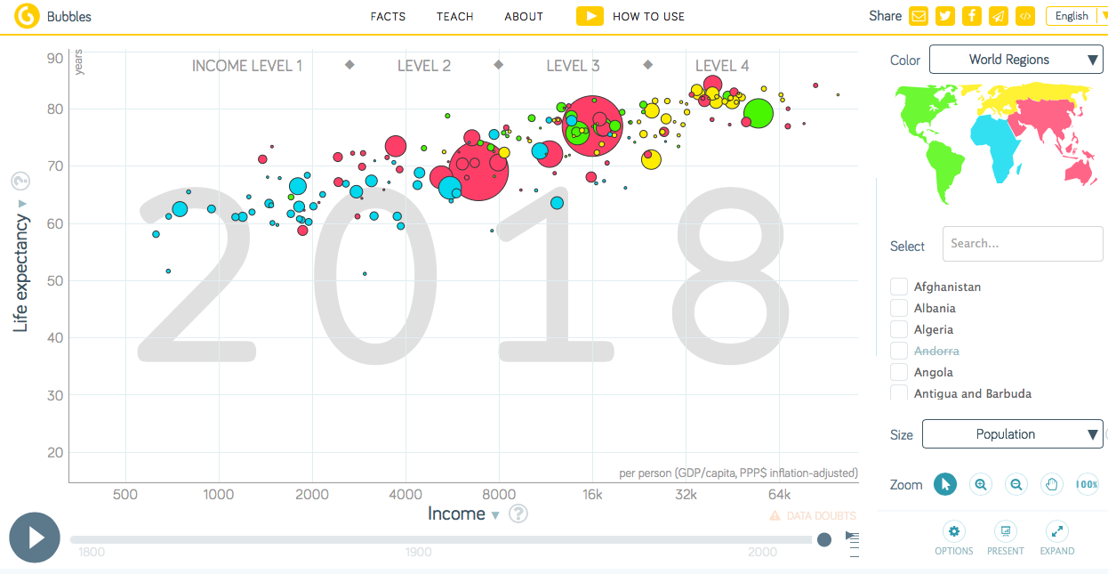
Industrial and Economic Development
Patterns and Processes
http://www.gapminder.org
http://atlas.cid.harvard.edu

Slide 22
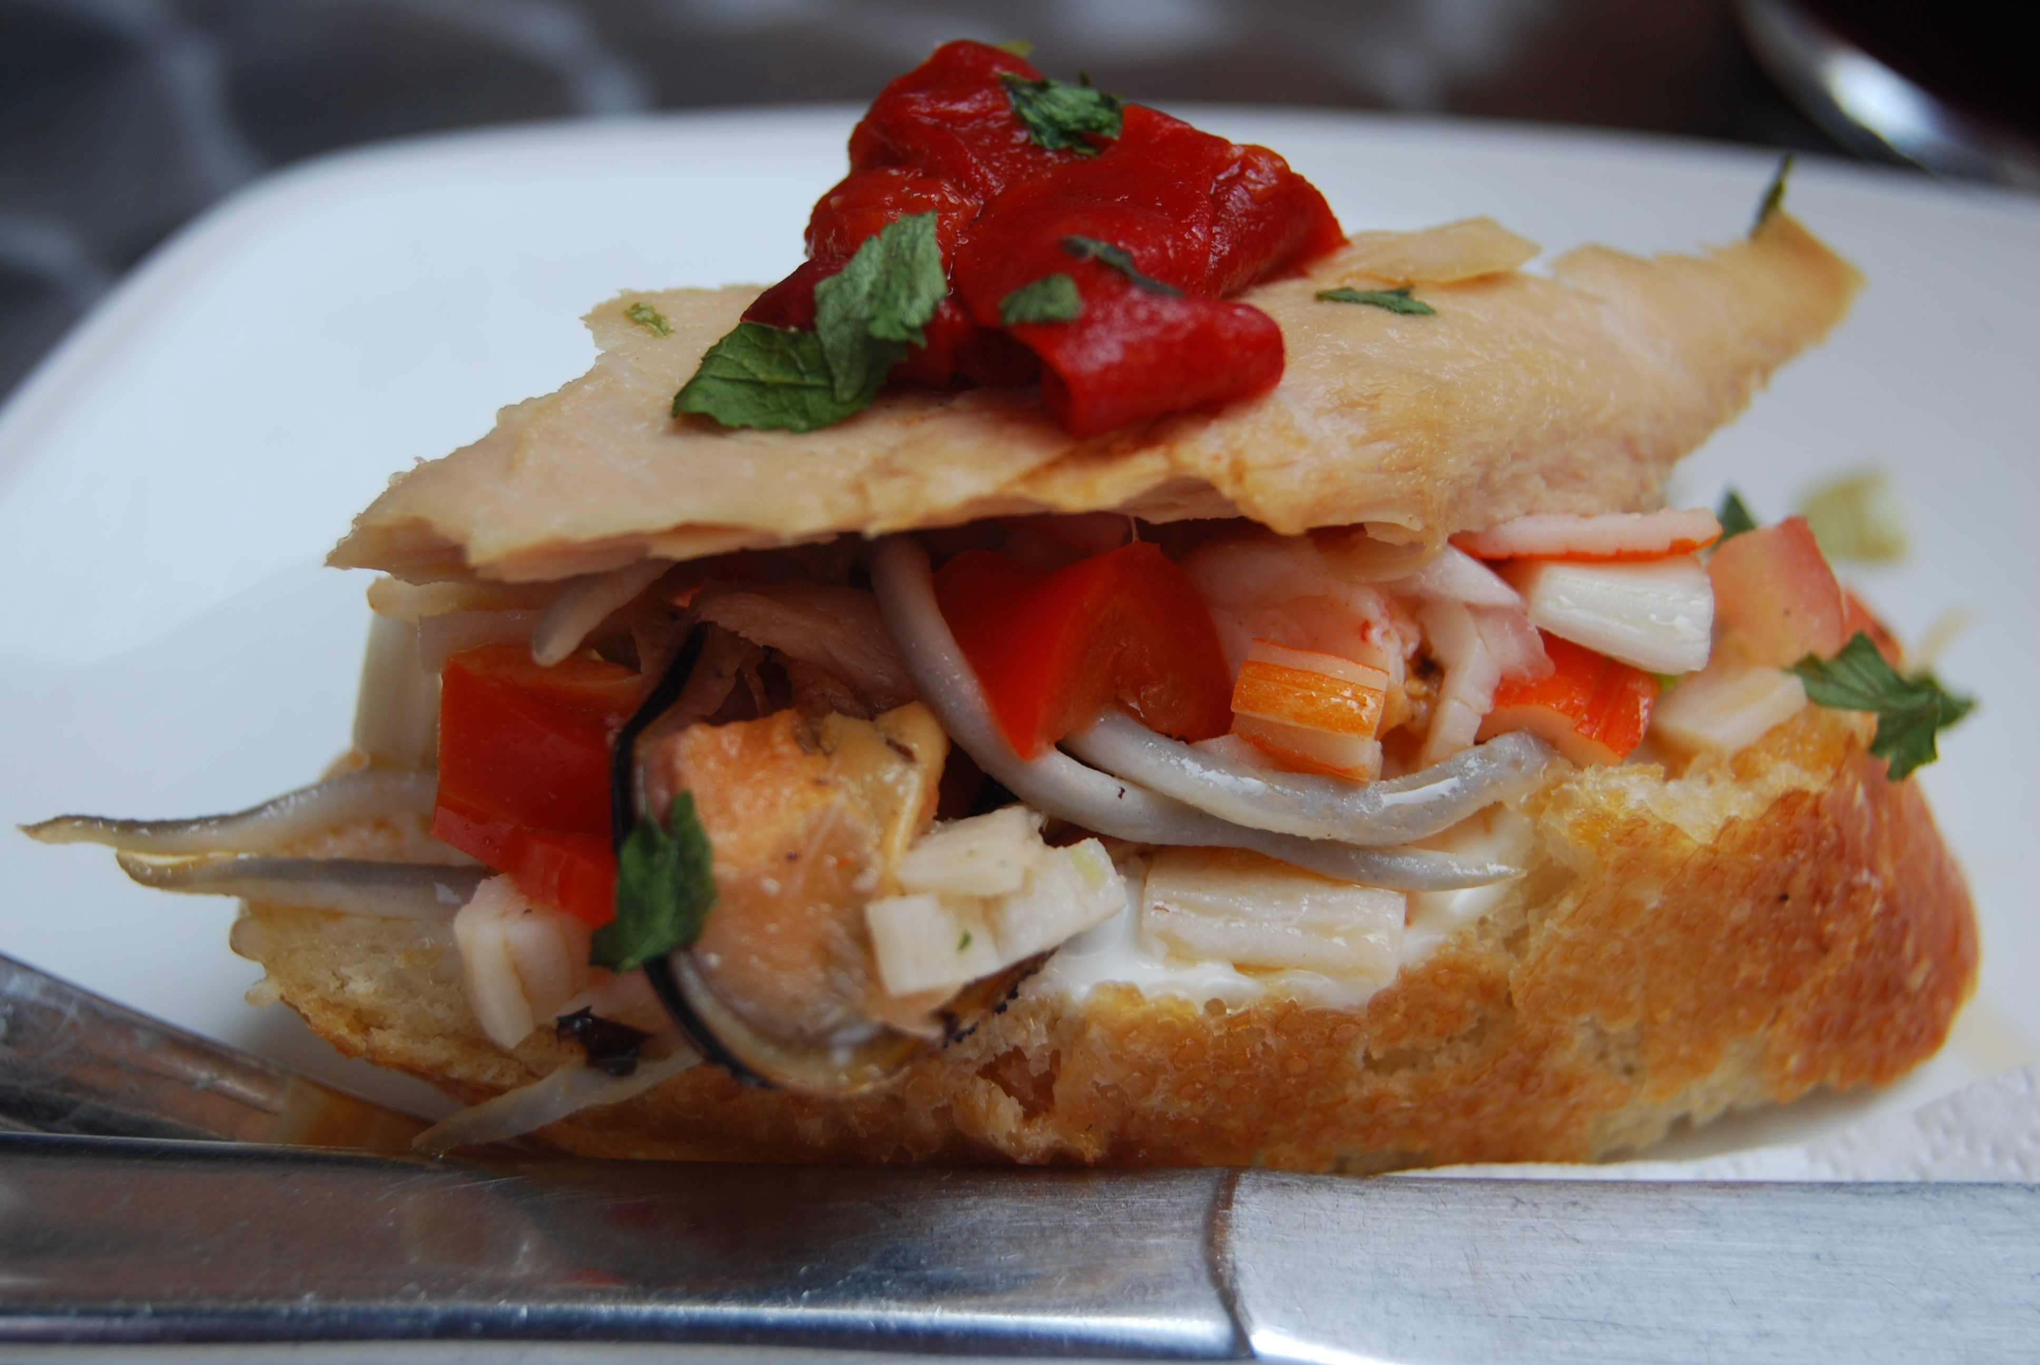
Agriculture
Bilbao, Spain

Slide 23
1
2
3
D
C
A
A Bananas | B Coffee | C Maize (Corn) | D Olive Oil | E Rice | F Wheat
4
5
6
F
E
B

Slide 24
http://hhsrobinson.org/HHSRobinson/GA.html

