Slide 1
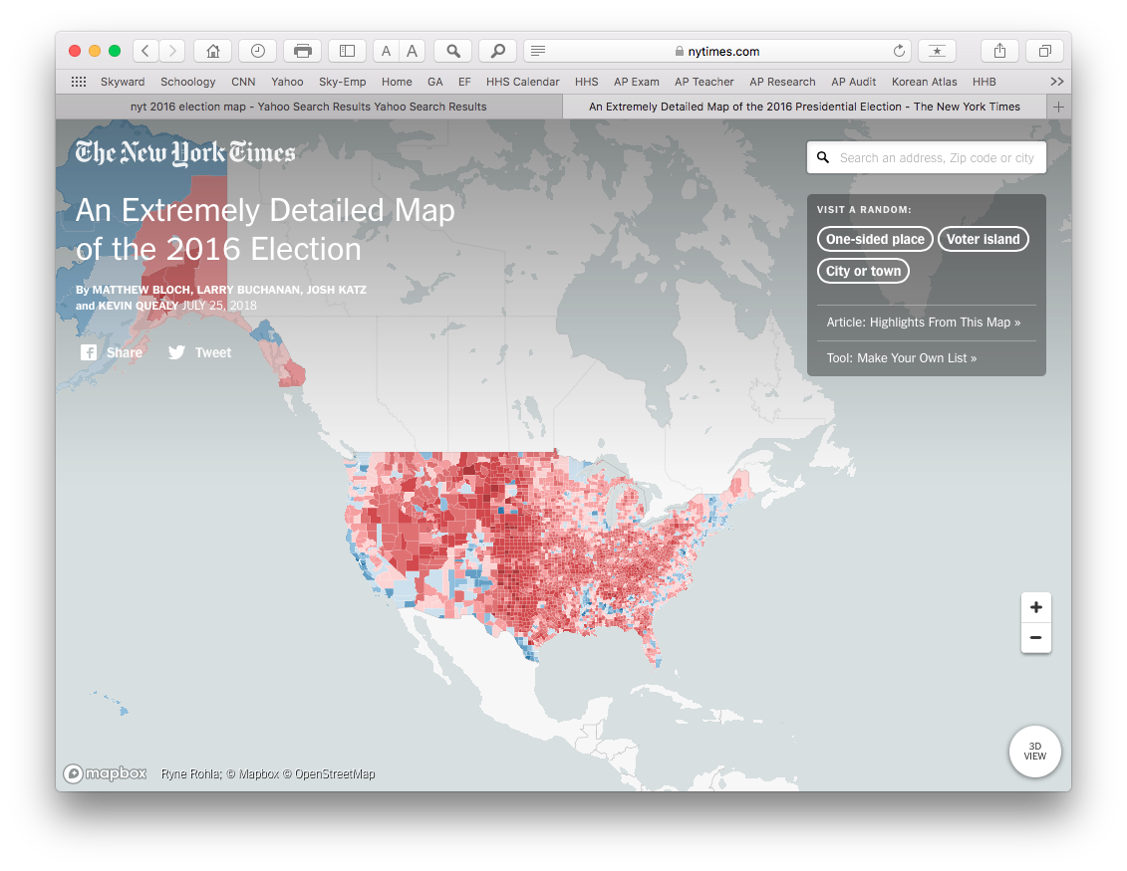
2016 Presidential Election
Scale Activity

Slide 2
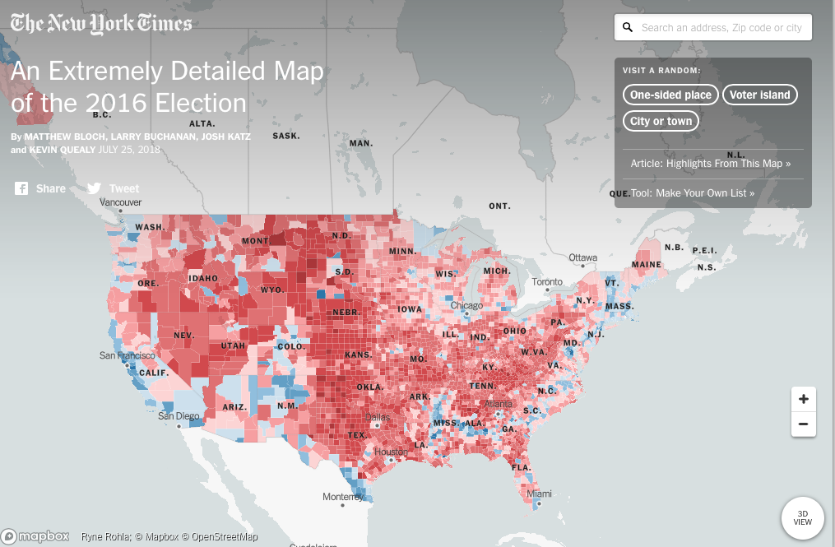
Google the following: “NYT An Extremely Detailed Map of 2016 Election”
https://www.nytimes.com/interactive/2018/upshot/election-2016-voting-precinct-maps.html?mtrref=www.google.com&gwh=8F01A2ABB01999A849AC0260103B52E6&gwt=pay

Slide 3
Directions for 2016 Presidential Scale Activity
Key Question to answer:
How does changing scale change one’s understanding of the patterns on the map?
Select any area of the United States that you believe will best answer the question.
You will examine this one area at a local, regional, and national level, and you will discuss in 2-3 paragraphs how changing the scale changes your understanding of the election results in this area.

Slide 4
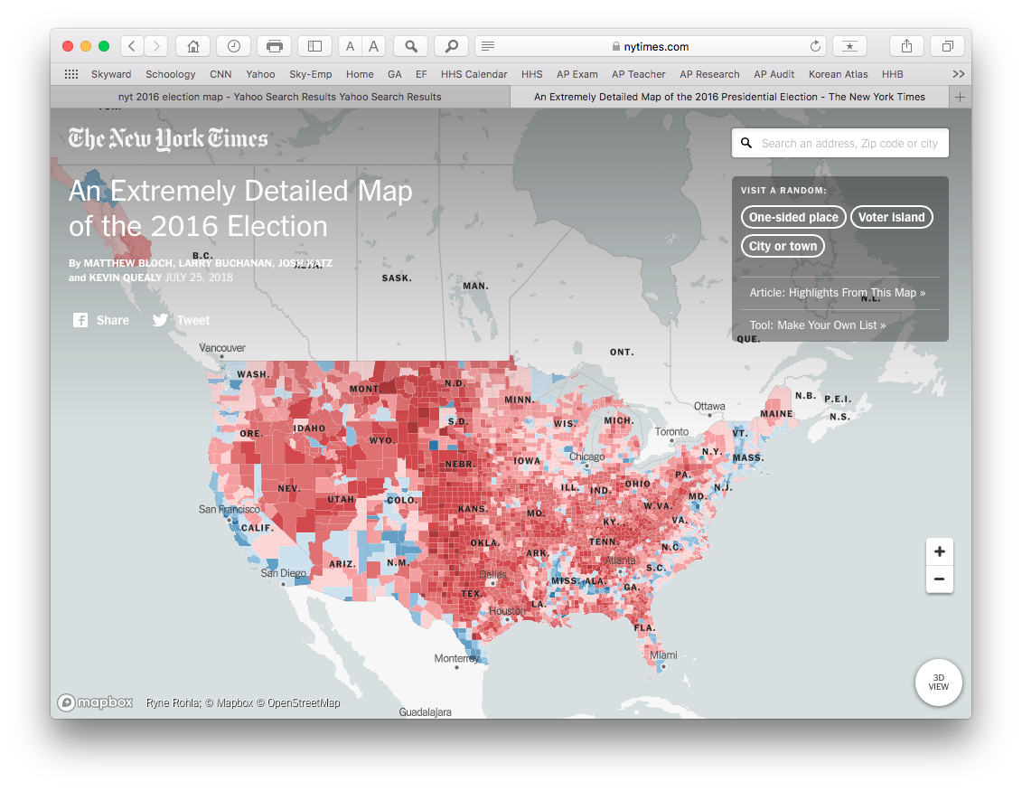
EXAMPLE - National

Slide 5
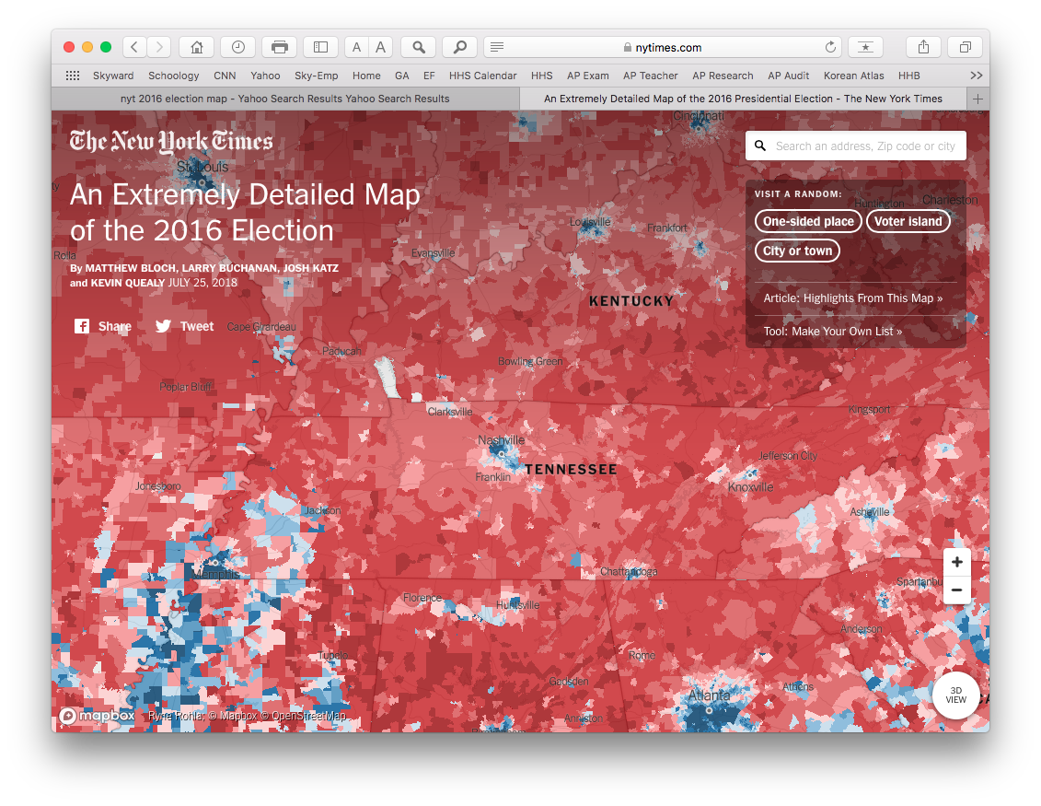
EXAMPLE - Regional

Slide 6
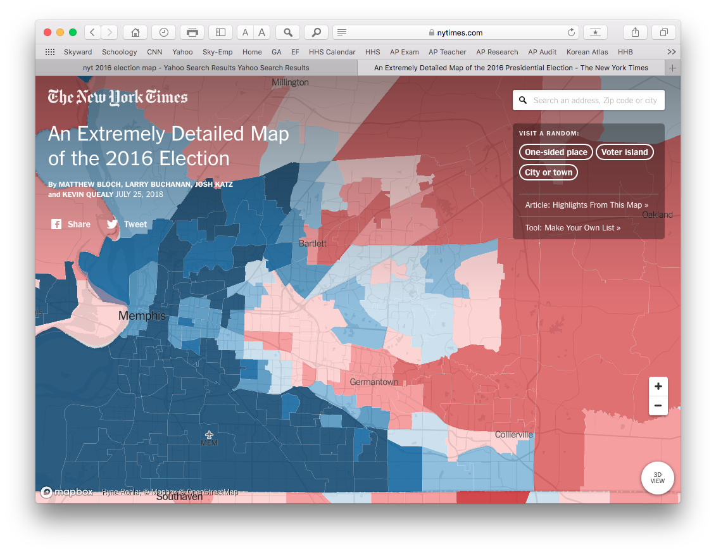
EXAMPLE - Local

Slide 7
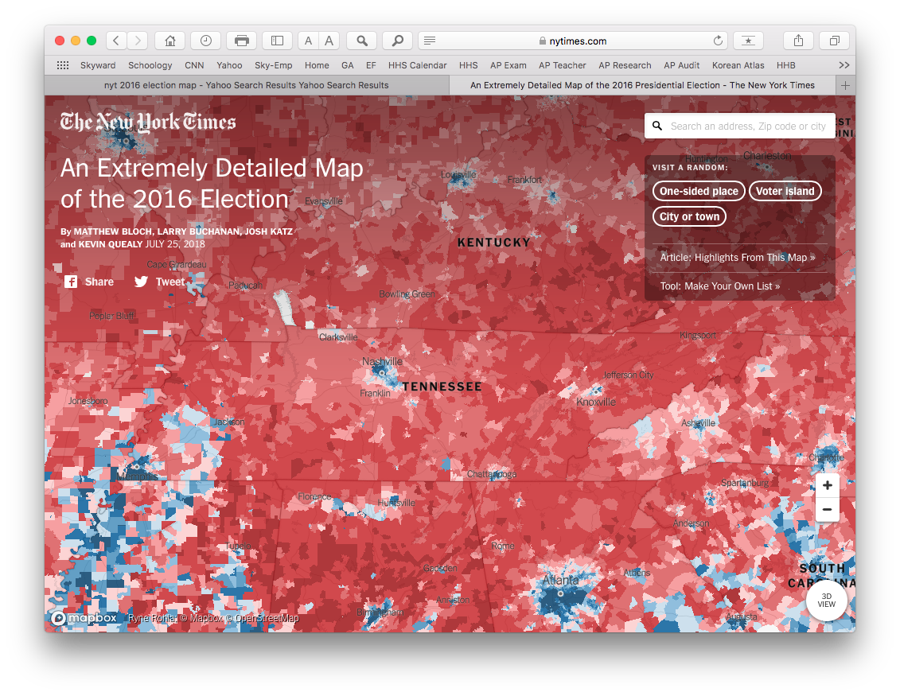
EXAMPLE - Regional

Slide 8
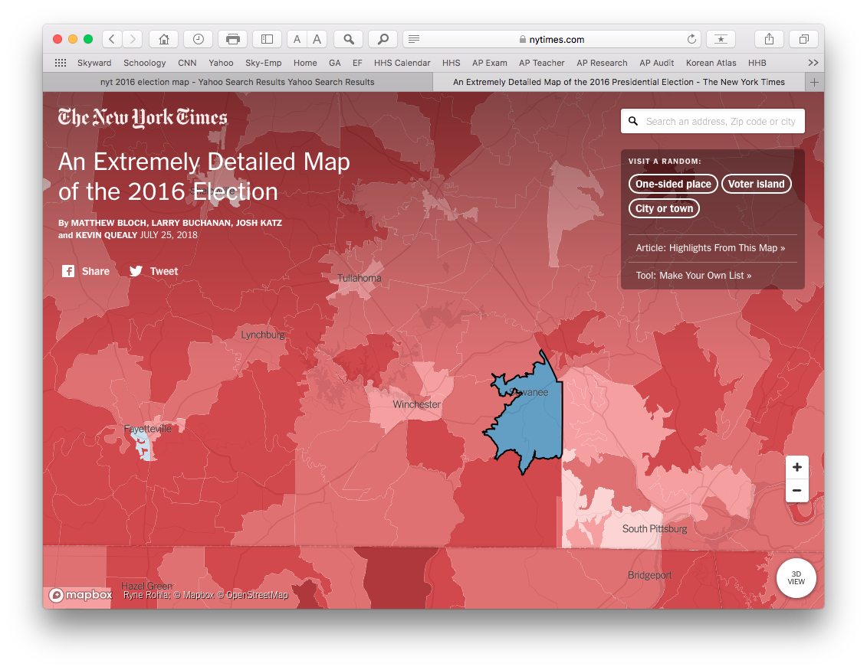
EXAMPLE - Local

Slide 9
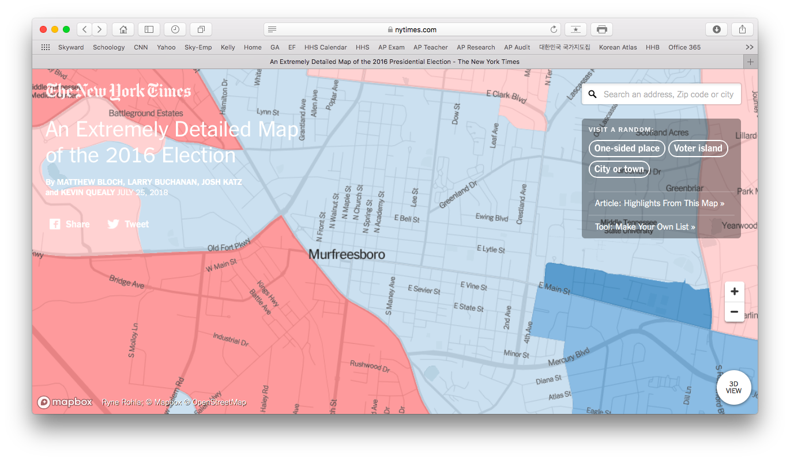

Slide 10
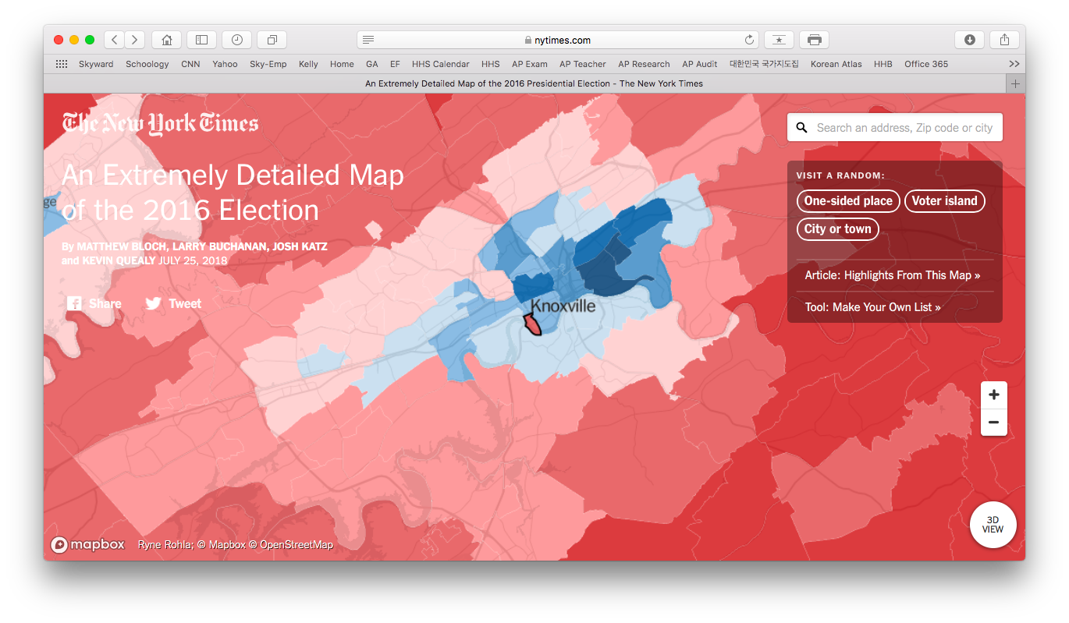

Slide 11
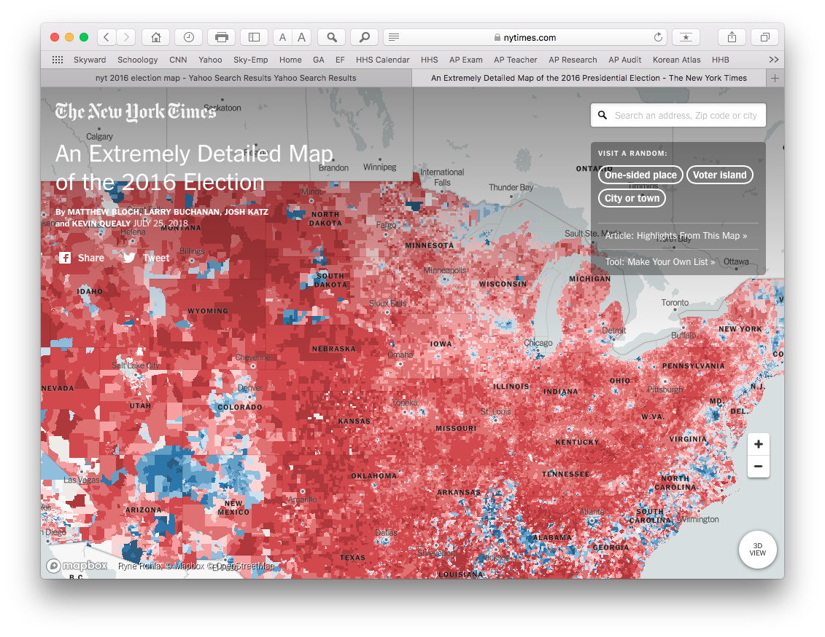
EXAMPLE - National

Slide 12
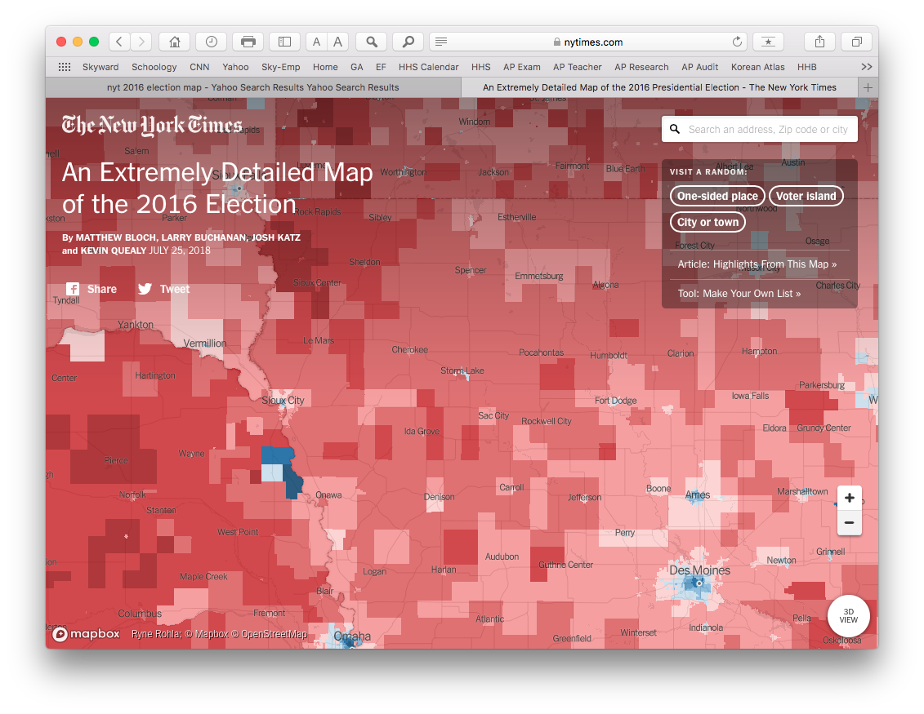
EXAMPLE - Regional

Slide 13
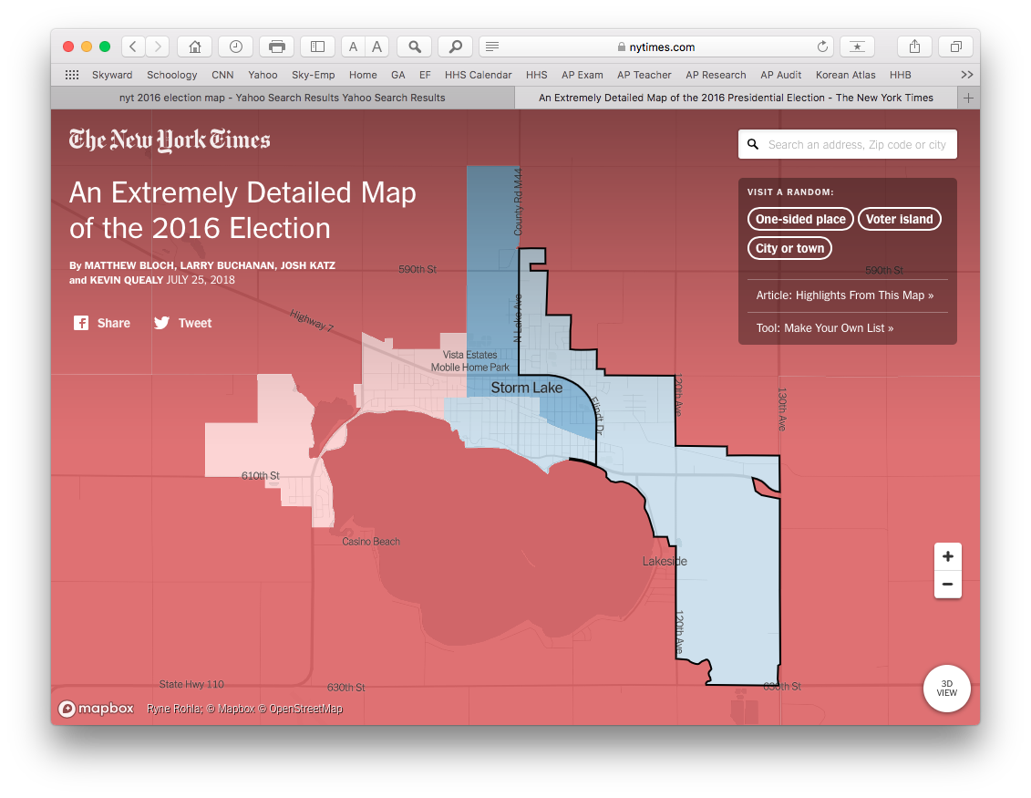
EXAMPLE - Local

Slide 14
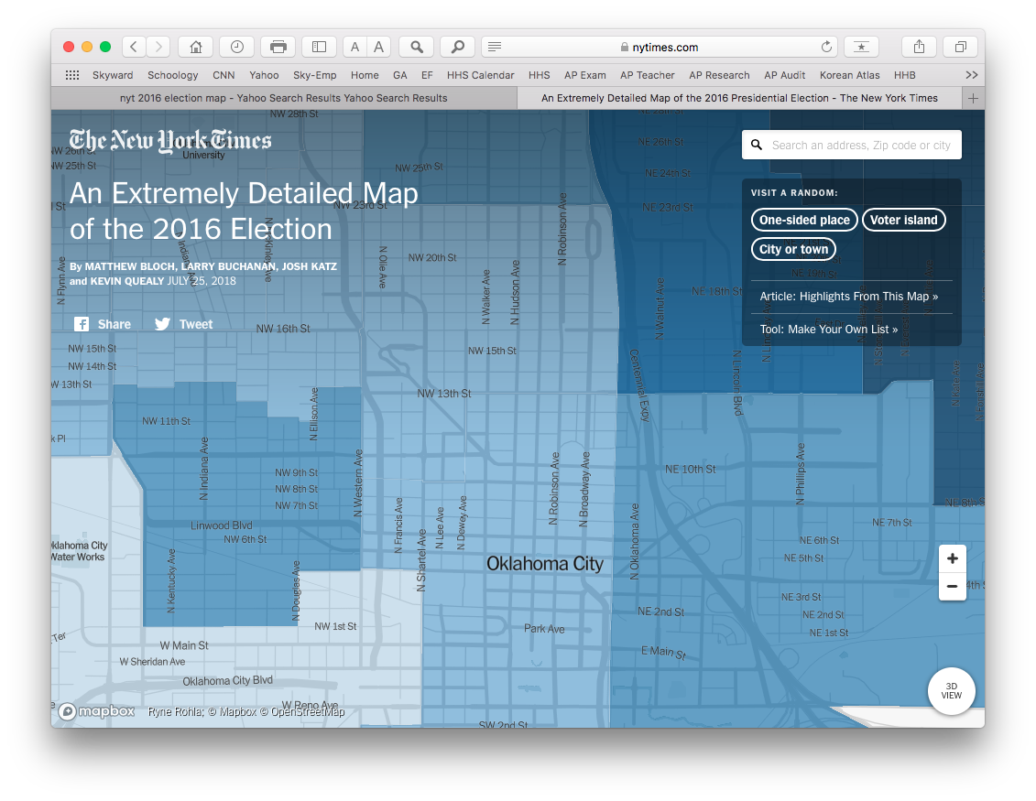
EXAMPLE - Local

Slide 15
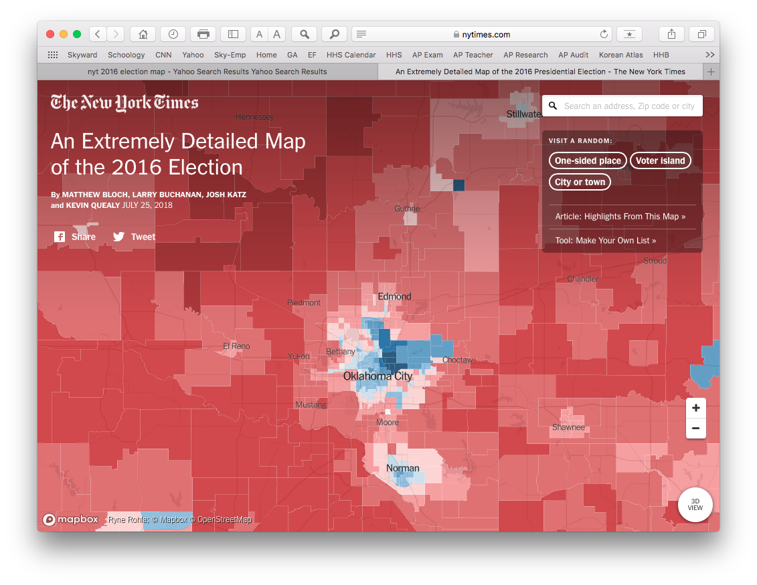
EXAMPLE - Regional

Slide 16
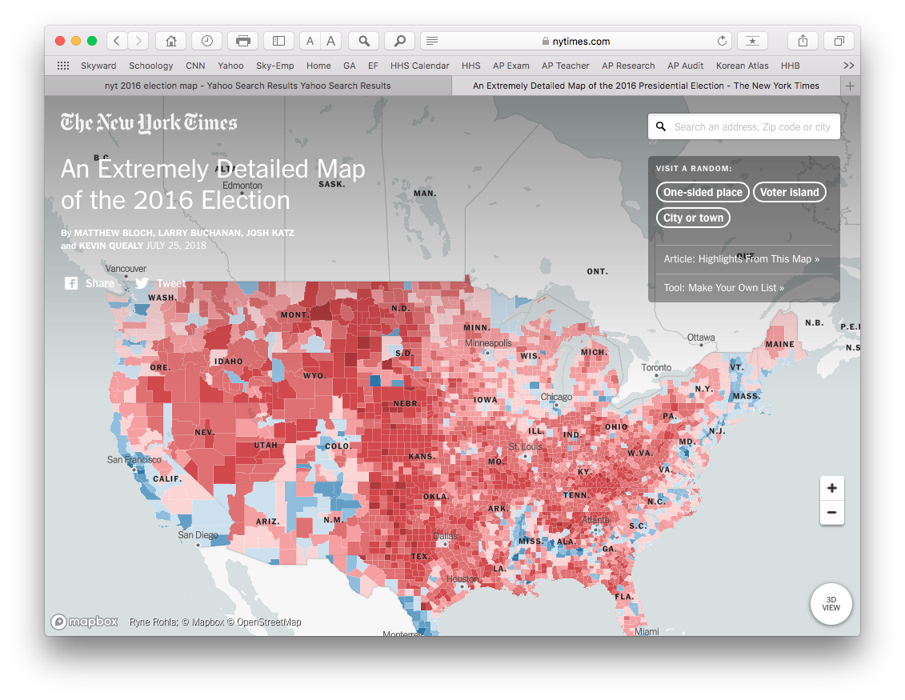
EXAMPLE - National

