Slide 1
Activities: “Speed Dating” Promoting engagement and student-centered learning
AP Human Geography
Kristi Neuroth

Slide 2
What are “speed dating” activities?
Speed dating activities are a type of jigsaw activity.
Students work on one component of the information and rotate with their peers to share what they learned.
Students meet in pairs for 2-3 minutes to share their information and then rotate to the next station.
Students work together to complete a chart (or some other form of assessment).

Slide 3
Farmers Only Project
Assignment Credit to Ashley Flood and Cassie Bates.
Purpose of the project: Help students understand the different types of agriculture (see corresponding AP Course Description Learning Objectives on the following slides).
Please see the accompanying documents:
Farmers Only Project Rubric
Farmers Only Template for Students
Farmers Only Slips for Desks
Farmers Only Slips for Students
Farmers Only Types of Agriculture Chart

Slide 4
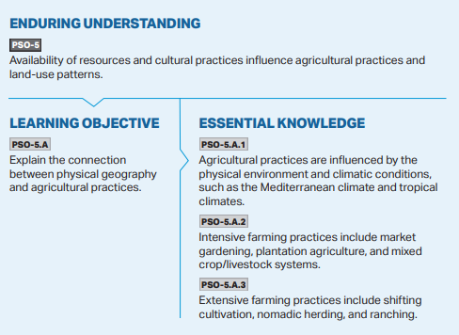
Connection to the AP Course Description

Slide 5
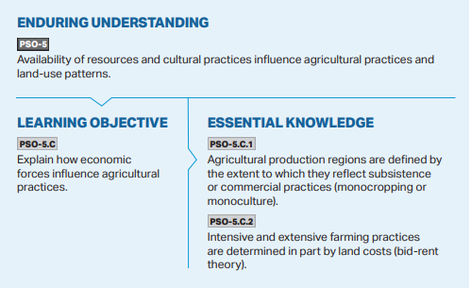
Connection to the
AP Course
Description

Slide 6
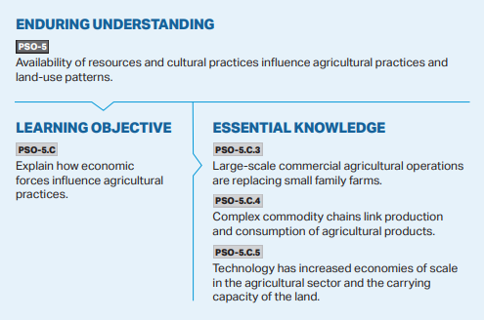
Connection to the AP Course Description

Slide 7
Instructions
1. Randomly assign each student to one of 12 types of agriculture (make sure there are at least 2 students in each class assigned to each type of agriculture).
2. Each student will create a “Farmers Only” dating profile based on the type of agriculture they were assigned (please see the templates for details).
3. On the assigned “speed dating” day each student will bring in their profile (printed out) and will share their profile with other students in the class.
4. Students will sit in pairs. They will discuss their types of agriculture and complete the “Types of Agriculture Chart.”
After 2-3 minutes of discussion one student of the pair will rotate to the next station and begin again.

Slide 8
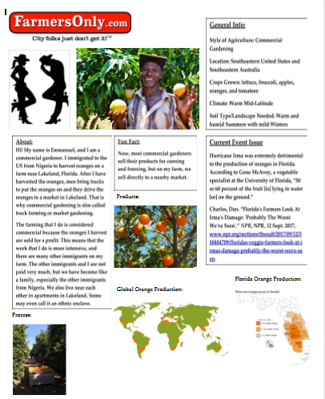
Student Sample

Slide 9
In-Class Instructions on Following Slides

Slide 10
Tuesday, February 14
Instructions:
Find the station you should start at based on your type of agriculture (if it is full go to the “Extra” stations)
Get out your Farmers Only Profile
If you have your RSVP for the travel meeting give that to me as well. Thanks!
Agenda:
Discuss due dates
Agriculture “Speed Dating”!

Slide 11
“Farmers Only Speed Dating”
Instructions:
You will have about 3-4 minutes to learn about the person you sit across from and share your profile.
As you chat you will fill out your chart.
When time is up you will move to the next station.

