Slide 1
Europe
A Trip Across the Atlantic

Slide 2
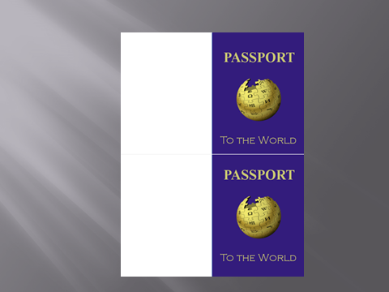
What do you need when you leave the country?
A Passport!

Slide 3
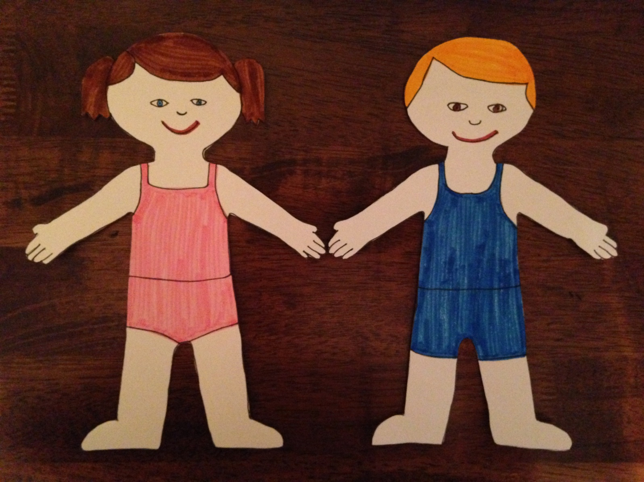
Meet Sally and Sam

Slide 4
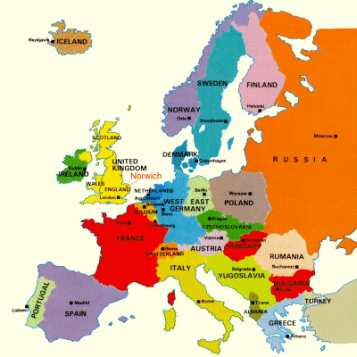
Europe

Slide 5
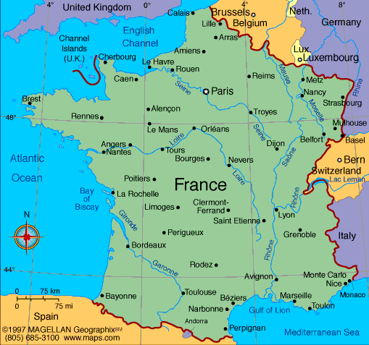
France

Slide 6
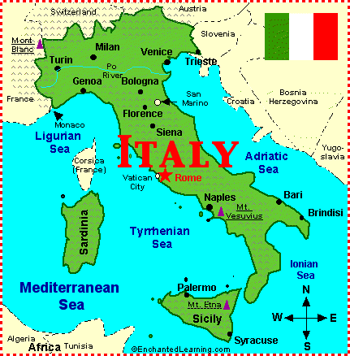
Italy

Slide 7
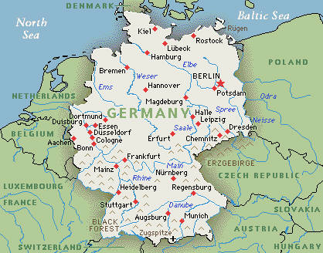
Germany

Slide 8
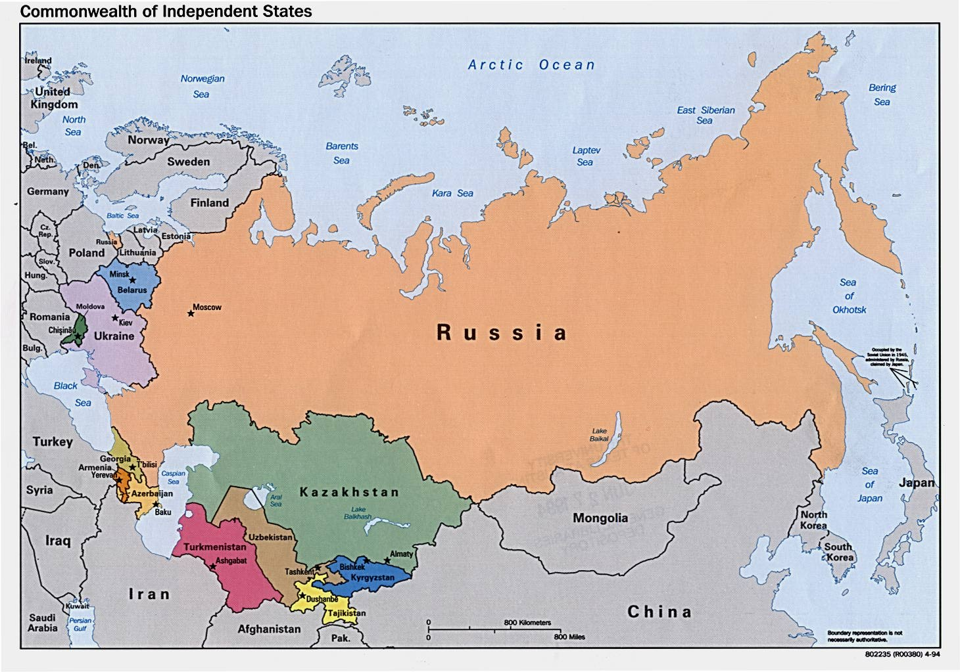
Russia

Slide 9
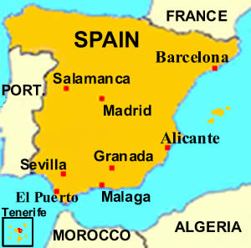
Spain

Slide 10
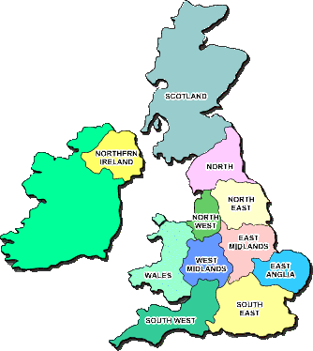
United Kingdom

Slide 11
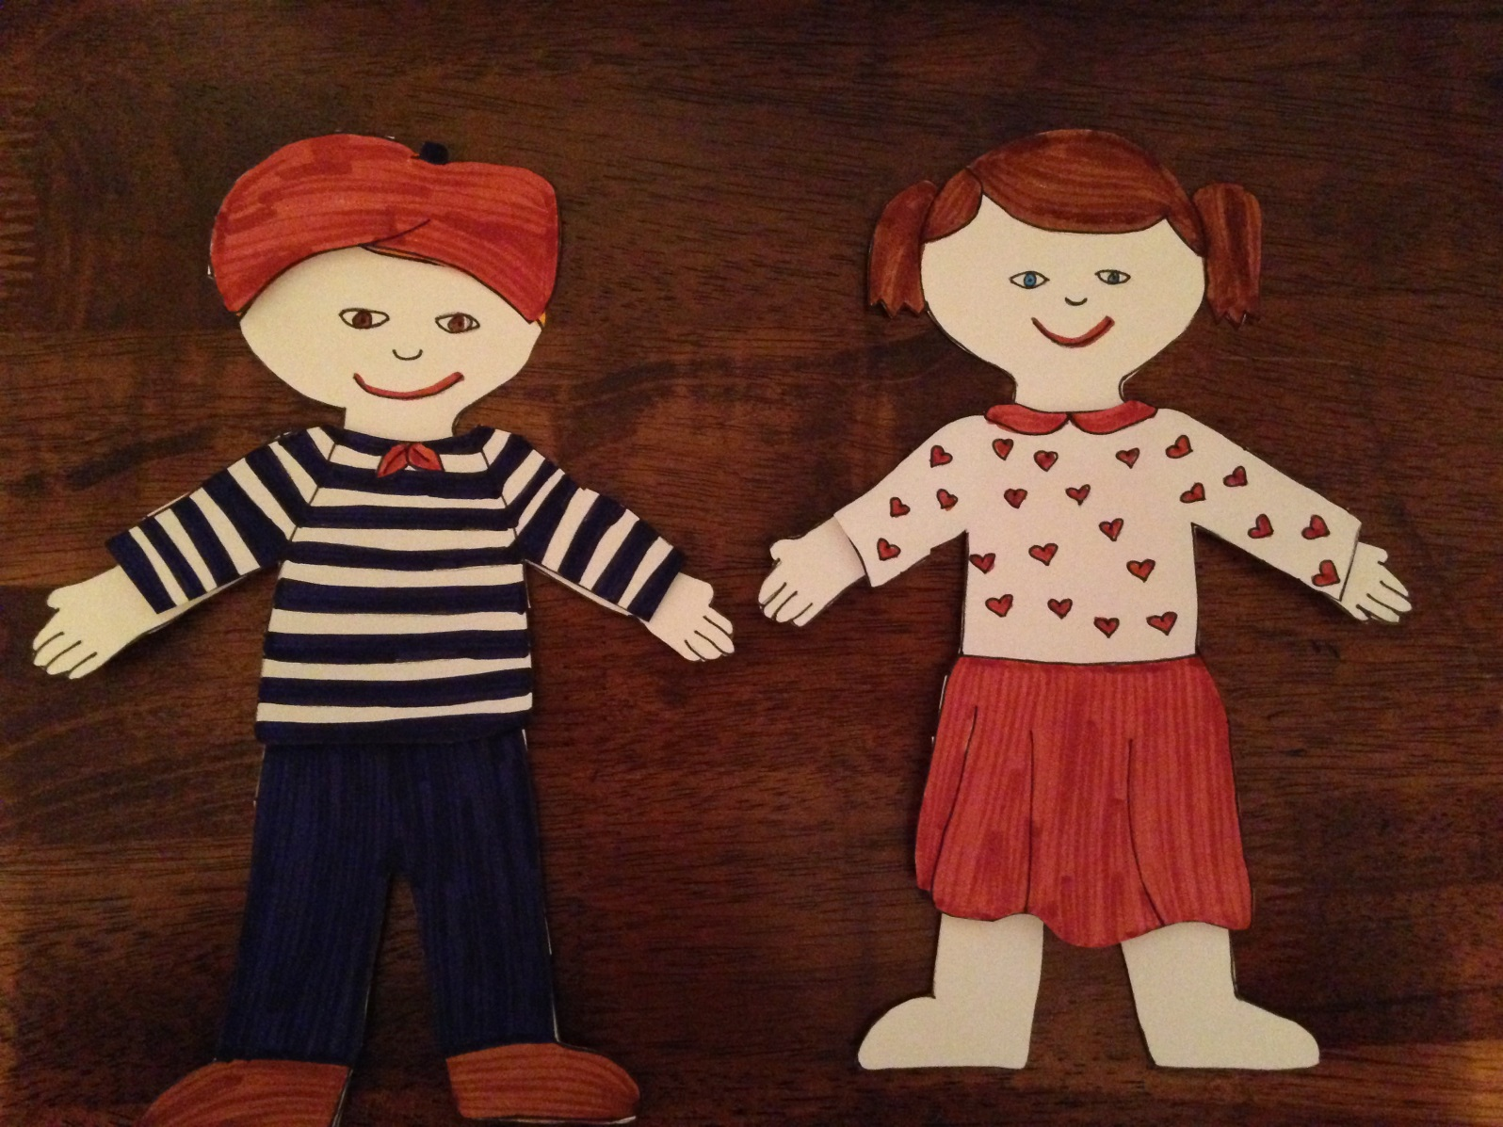
France

Slide 12
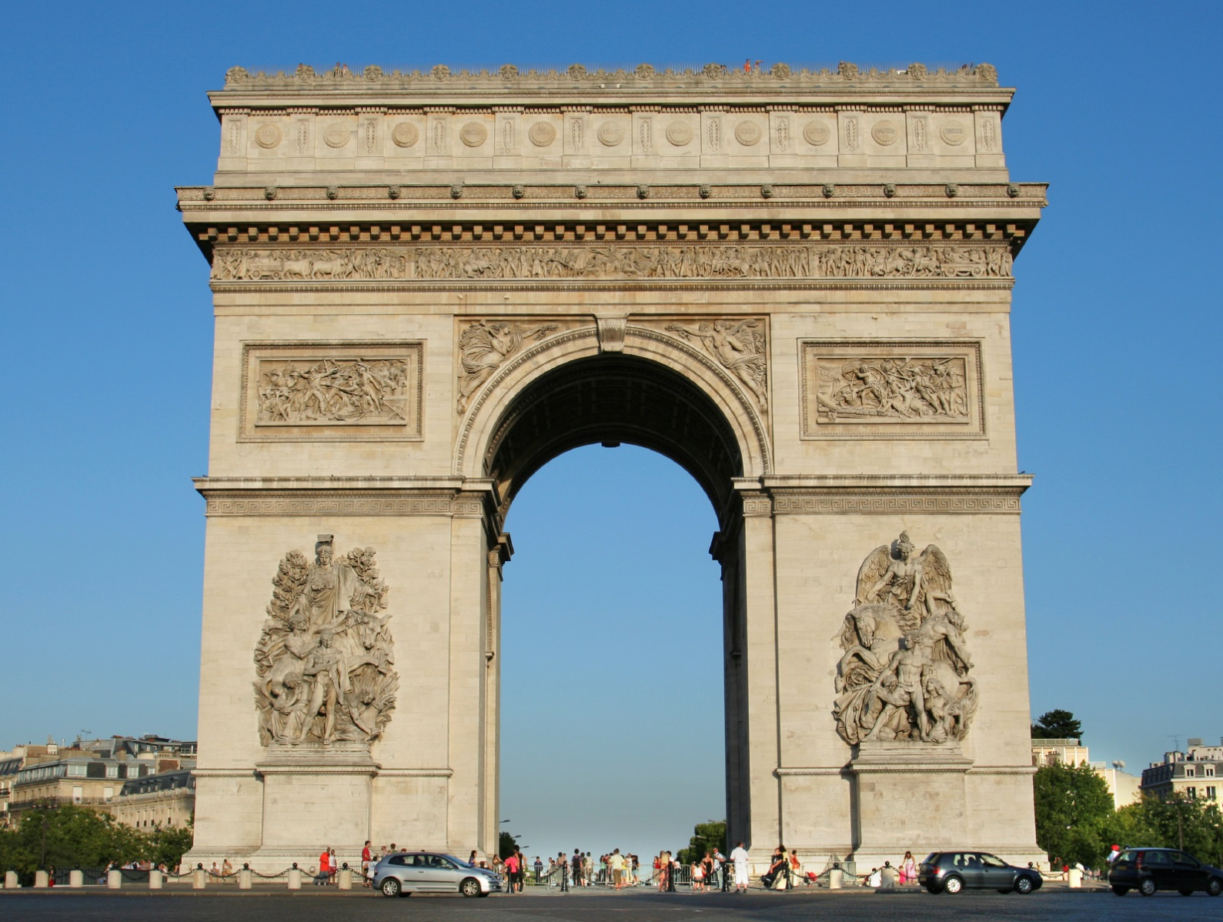
Arc de triomphe

Slide 13
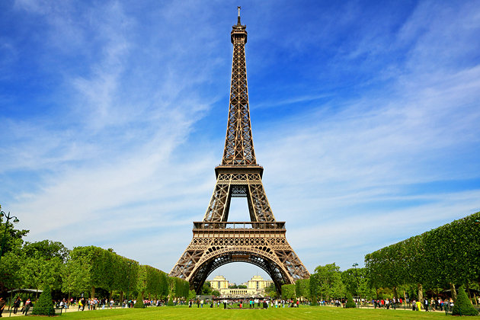
Eiffel Tower

Slide 14
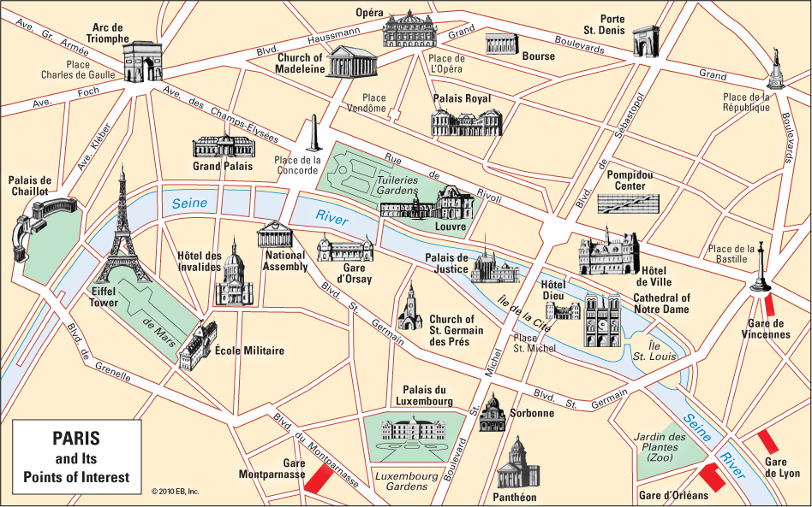

Slide 15
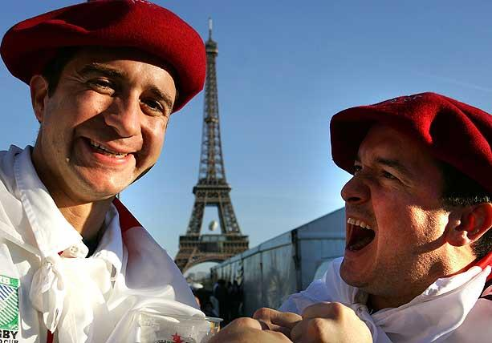
What language do people speak in France?

Slide 16
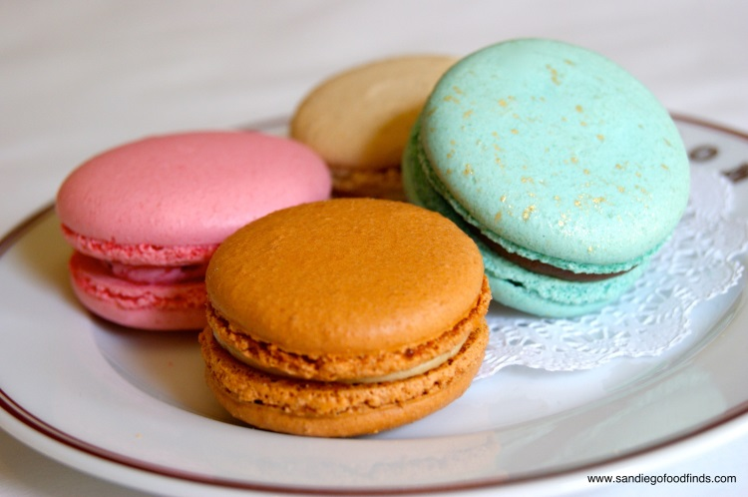
Sally and Sam taste French food

Slide 17
The French flag

Slide 18
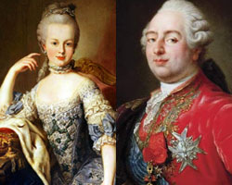
Does France have a king?
No. France used to have a king and a queen, but there was a revolution in 1789 and France became a republic.

Slide 19
Palace of Versailles

