Slide 1
TOP TEN MOST POPULOUS COUNTRIES IN 2015 AND IN 2050
2015 |  | 2050
Country | Population | Country | Population
China | 1.372 | India | 1.660
India | 1.314 | China | 1.366
United States | 321 | United States | 398
Indonesia | 256 | Nigeria | 397
Brazil | 205 | Indonesia | 366
Pakistan | 199 | Pakistan | 344
Nigeria | 182 | Brazil | 226
Bangladesh | 160 | Bangladesh | 202
Russia | 144 | Congo, Dem. Rep. | 194
Mexico | 127 | Ethipoa | 165
1
2
3
4
5
6
7
8
9
10
What will probably be the Top Ten Most Populous Countries in 2050? HINTS 1. Eight of the countries are the same. Of those eight only three are in the same numerical position as they were in 2015. 2. The two new countries are from the same continent. 3. The two countries not found on the list in 2050 are from two different continents., and neither are in Asia.
1
2
3
4
5
6
7
8
9
10

Slide 2
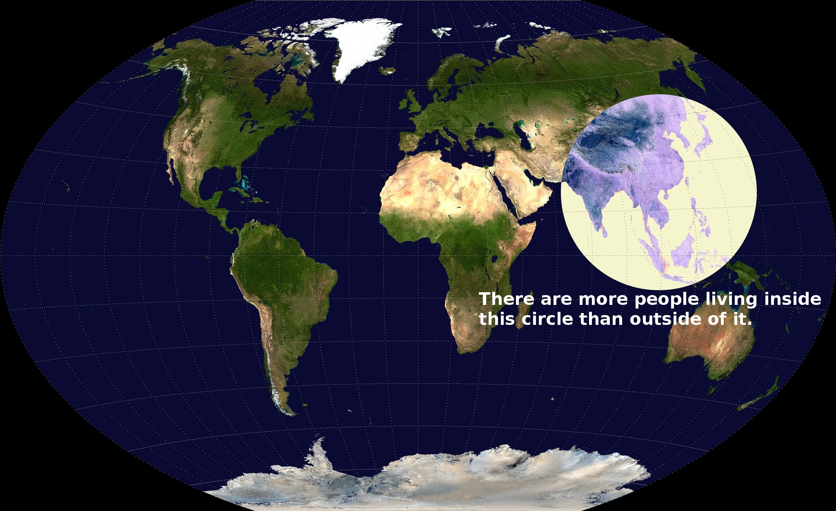
How would we determine if the statement under the circle is true?

Slide 3
Country | Population
Bangladesh
Bhutan
Cambodia
China
Japan
India
Indonesia
Laos
Malaysia
Mongolia
Myanmar
Nepal
North Korea
Pakistan
Philippines
Singapore
South Korea
Sri Lanka
Taiwan
Thailand
Vietnam
Location | Population Totals
World
Countries in the circle.
Explain if there are more people living inside the circle or outside of the circle.

Slide 4
Country | Population
Location | Population Totals
World
Countries in the circle.
Explain if there are more people living inside the circle or outside of the circle.

Slide 5
Country | Population (million)
Bangladesh | 156.6
Bhutan | 0.7
Cambodia | 14.4
China, Hong Kong, and Macao | 1,365.2
Japan | 127.3
India | 1,276.5
Indonesia | 248.5
Laos | 6.7
Malaysia | 29.8
Mongolia | 2.8
Myanmar | 53.3
Nepal | 26.8
North Korea | 24.7
Pakistan | 190.7
Philippines | 96.2
Singapore | 5.4
South Korea | 50.2
Sri Lanka | 20.5
Taiwan | 23.4
Thailand | 66.2
Vietnam | 89.7

Slide 6
Location | Population
World | 7,137,000,000 (7.1 Billion)
Countries in the circle. | 3,875,600,000 (3.9 Billion)

